Slide 1
Why you should understand the basics
Immigration status intersects with most areas of law
Avoiding mistakes or mishaps in the process
Your clients may have questions and anxieties about how their immigration status effects their cases, or what risks they face with a particular outcome.

Slide 2
Key Terms
Citizen
Naturalization
Lawful Permanent Resident (LPR)
Green Card
Immigrant
Non-immigrant
Undocumented
Refugee
Asylee
Asylum Seeker
Removal/Deportation
EWI

Slide 3
Work authorization
To work in the US legally you must demonstrate that you are a US citizen or a non citizen authorized to work. All employees by law complete a form I-9 and provide proof of US citizenship or work authorization when hired.
Not all immigration statuses are eligible for work authorization. Without work authorization, you cannot legally work in the US and in most cases cannot obtain a driver’s license or state ID, making all aspects of life more difficult.
If you are eligible for an Employment Authorization Document (EAD) filing can be expensive and it can take months or years for USCIS to issue your card. Replacement documents take just as long. During the interim, working, driving etc can be impossible
Most non-immigrant categories are not EAD eligible, with some exceptions like TPS and DACA
The effects of not being able to work extend to the non-citizen’s children in mixed status families. It can make your clients vulnerable to abuse by those they are dependent on, and fearful of law enforcement contact

Slide 4
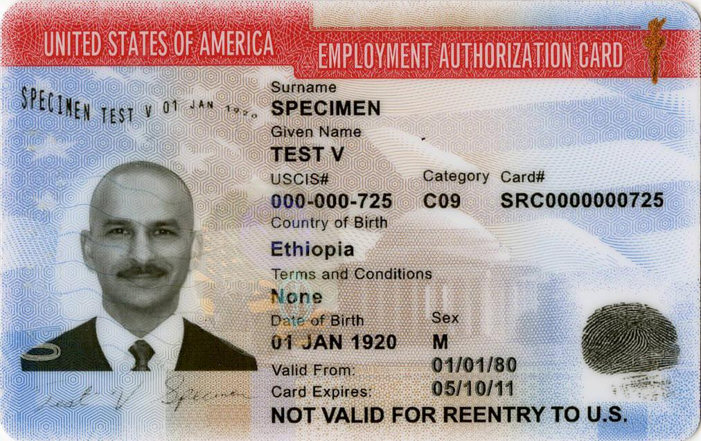

Slide 5
What is your client’s immigration status?
Non-immigrant status: lawful status that is intended to be temporary. These statuses are not a path to LPR or US Citizenship, for example:
Student visas
Temporary worker visas
Visitor visas
DACA
Humanitarian Parole
Temporary Protected Status (TPS)
Immigrant status: Status that is indented to be permanent
Lawful Permanent Residents
Refugees
Asylees
“Overstay”, “out of status” etc.: these are not legal terms but are used to refer to situations where an individual had immigration status which either expired or was revoked.

Slide 6
What is your client’s immigration status?
Refugee: This individual was resettled to the US as a refugee, and had refugee status on arrival. They likely fled war or persecution in their home country and spent years living in a UNHCR refugee camp before being resettled. This is a permanent status and work authorized. Refugees can apply for LPR status 1 year after they enter the US.
Asylee: This individual applied for asylum while already in the US because they have experienced persecution or fear future persecution in their home country on account of their race, nationality, religion, political opinion or membership in a particular social group. They have had their asylum application granted, which permits them to live and work permanently in the US. They can apply for LPR status 1 year after their asylum was granted.
Asylum Seeker/Asylum Applicant: They have applied for or are working towards applying for asylum.

Slide 7
What is your client’s immigration status?
“Undocumented”: also not a legal term but often used to refer to the immigration status of someone who entered the US without authorization and without being detected by border authorities. Many will incorrectly refer to any individual who crosses a land border as “undocumented” even when that individual presented themselves to border authorities, requested asylum, and was paroled into the US.
Parole: There are multiple categories of parole but you will most likely encounter Parole in the Public Interest, which, broadly, is a discretionary humanitarian status granted to individuals at the US border to allow them to remain in the US temporarily in order to seek asylum. It is valid for one year. Although you are able to request Employment Authorization under Humanitarian Parole, it takes so long to issue Employment Authorization that the parole status, and therefore employment eligibility, will likely expire before Employment Authorization is issued.

Slide 8
What is your client’s immigration status?
“Undocumented”: also not a legal term but often used to refer to the immigration status of someone who entered the US without authorization and without being detected by border authorities. Many will incorrectly refer to any individual who crosses a land border as “undocumented” even when that individual presented themselves to border authorities, requested asylum, and was paroled into the US.
Parole: There are multiple categories of parole but you will most likely encounter Parole in the Public Interest, which, broadly, is a discretionary humanitarian status granted to individuals at the US border to allow them to remain in the US temporarily in order to seek asylum. It is valid for one year. Although you are able to request Employment Authorization under Humanitarian Parole, it takes so long to issue Employment Authorization that the parole status, and therefore employment eligibility, will likely expire before Employment Authorization is issued.

Slide 9
Removal Proceedings
The Immigration Court for Ohio is in Cleveland, Ohio
Removal is colloquially referred to as deportation
Clients may be in removal because they filed an immigration petition that was denied, overstayed and had a subsequent law enforcement encounter, or were convicted of an offense which makes them removable.
Individuals who present themselves at the US/Mexico border to request asylum are generally given a Credible Fear Interview and, if successful, put into removal proceedings and paroled into the US in order to file for asylum defensively before the Court.
“Death penalty cases in a traffic court setting”: removal isn’t considered a criminal sanction, therefore there is no right to counsel if you cannot afford it. Most evidentiary laws, hearsay laws, etc. do not apply. Judges are subject to very little oversight especially since the appeals process can take several years and representation is prohibitively expensive.
Asylum Clock: causing delays by requesting a change of venue, time to find an attorney etc. can delay a client’s ability to obtain Work Authorization for months or years

Slide 10
Becoming a Lawful Permanent Resident (LPR)
Colloquially referred to as “Green Card” holders
To naturalize, you must be an LPR for 5 years, or 3 years if married to a US citizen the entire 3 years
To become an LPR, you must qualify for one of the very limited categories
Entering without inspection disqualifies an individual from the vast majority of legal statuses, including family based visas in most situations. Notable exceptions to this rule are asylum, VAWA and U visas

Slide 11
Becoming an LPR
Family reunification:
Family reunification is the most way individual immigrate to the US
A US citizen may petition for their spouse, under 21 unmarried children, parents (if the US citizen is over 21), fiance/e as “immediate” relatives (no wait except for the processing time, which is over a year). A US citizen may also petition for their over 21 children (wait list is about 9 years) married children (15 year wait) and siblings ( 16 year wait)
An LPR may file for their spouses and children (3 year wait) and unmarried over 21 children (8 year wait) but NOT parents, fiance/es, or married children
All of these wait times are longer for China, India, the Philippines and especially Mexico. The wait for a US citizen to bring their Mexican Citizen adult children of the US is 22 years, for example
Asylees: You may apply for LPR status 1 year after being granted asylum
Refugees: You may apply for LPR status 1 year after entering the US as a refugee

Slide 12
Becoming an LPR
VAWA: LPR status for individuals who are or were legally married to a US citizen or LPR and subject to battery or extreme cruelty.
U Visas: victims of specified crimes who were helpful to law enforcement in investigating that crime (over a decade from application to LPR status, most of which no work authorization is available)
T Visas: for victims of certain types of human trafficking
Employment: Some employment visas are immigrant visas, and allow visa holders to apply for LPR status after a certain number of years
Entrepreneur Visas: minimum $500,000 investment and 10 jobs.
SIV: Certain unaccompanied minors, religious workers, and Afghan and Iraqi citizens who worked for the US for more than 1 year for US armed forces or contractors.

Slide 13
Becoming an LPR
Registry: Continues residence in the US since 01/01/1972
S Visa: Informant visas. “Unicorn” visas with about a dozen being issued per year. Law enforcement often promises S visas but rarely delivers.
Diversity Visas: “Lottery” visas for individuals from countries underrepresented in the US
“Special Programs” such as:
Cuban adjustment act
Lautenberg parole for certain religious minorities from the former USSR
Diplomats or high ranking officials unable to return home (Section 13 of the Act of September 11, 1957)
Haitian Refugee Immigration Fairness Act (for Haitians present in the US since 1995)
Liberian Refugee International Fairness (closed in 2021)

Slide 14
Becoming an LPR: Barriers
Expense: filing fees alone can be thousands per person, before factoring in attorneys fees
USCIS errors causing years of delay
Failure of USCIS to review evidence
Many decisions are discretionary with little oversight. Appeals process can take years and are extremely expensive
Power dynamics: spouse petitions in particular create a power imbalance that attracts abusers

Slide 15
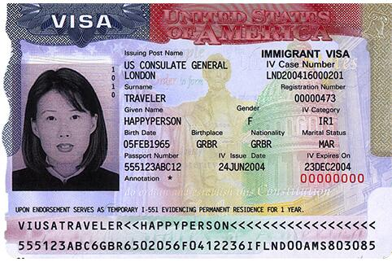

Slide 16
Becoming a US Citizen: 4 Ways
Birth in the US: "All persons born or naturalized in the United States, and subject to the jurisdiction thereof, are citizens of the United States and of the State wherein they reside." (14th Amendment of the US Constitution, ratified July 9, 1868)
Birth abroad to US citizen parents or parent: There are various physical presence requirements for the parent/parents, depending on when the child was born.
After birth, but before the age of 18 when a parent naturalizes. (In general child must be in the US as an LPR)
Naturalization: this is the process of applying for US citizenship after 5 years of LPR status, or 3 years of LPR status if married to a US citizen during the entire 3 years

Slide 17
Naturalizing
Eligible after 5 years of LPR status or 3 if married to a US Citizen for those 3 years
Physical presence requirements
Filing fee of $725
English and Civics test
Oath of Allegiance
Good Moral Character
Barriers:
Expense
Delayed processing times which can result in revocation of some benefits
English and civics test. Although some requirements may be waived due to disability or illness, USCIS does not consider lack of education in childhood or inability to read or write in native language

Slide 18
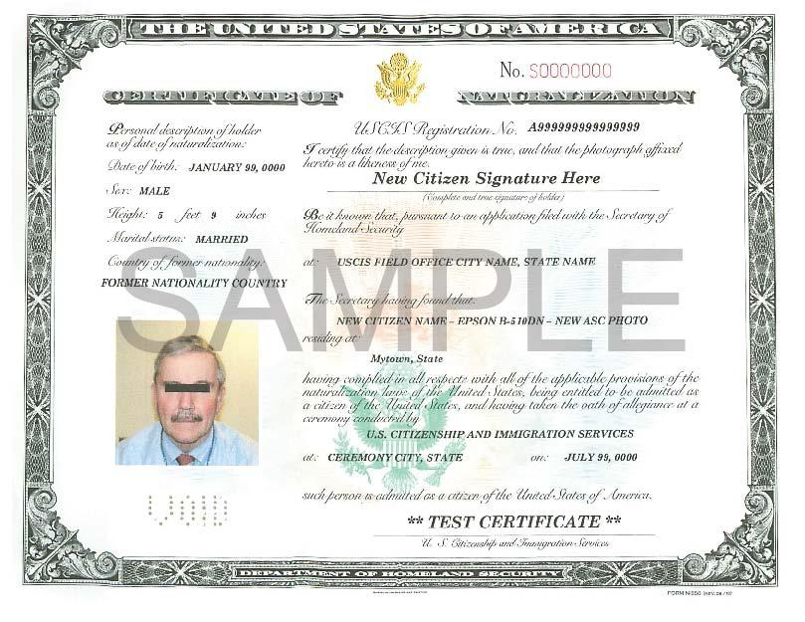

Slide 19
Common Immigration Myths
Myth: Undocumented immigrants get benefits like government housing, food stamps, Medicaid, etc.
Fact: Undocumented immigrants are not eligible for benefits. The vast majority of immigrants in general, including beneficiaries of family based petitions, are not eligible for benefits. Only a few humanitarian categories like TPS, asylees and refugees are eligible.
Myth: Undocumented immigrants don’t pay taxes.
Fact: The vast majority of immigrants who work “under the table” or with an assumed identity (using someone else’s green card, for example) pay taxes either with an ITIN, or via the assumed identity. Despite paying into taxes, they cannot get tax funded benefits like Social Security retirement income, unemployment, etc.

Slide 20
Common Immigration Myths
Myth: Undocumented immigrants can just have a child in the US and get status through the child
Fact: Having a US citizen child provides 0 immigration benefit to the parent. A US citizen child cannot petition for their parents until they are 21 years old. If the parent entered without inspection, they cannot get LPR status through their child. Having a US citizen child will not prevent the parents from being deported.
Myth: Just marry a US citizen!
Fact: US citizens may petition for their spouses, but it is expensive, discretionary, and has a high evidentiary bar. If your spouse is in the US without valid status, there is risk in alerting USCIS to their presence by petitioning for them. USCIS denies many completely valid marriage petitions, putting the intended beneficiary into removal proceedings. If the non-citizen spouse entered the US without inspection, they cannot benefit from a spousal petition except in extremely limited circumstances.

Slide 21
Common Immigration Myths
Myth: Just apply for a green card!
Fact: Every TV show with an immigration subplot makes this error. To be eligible for LPR status (a green card) you must fit into one of the incredibly few and narrow categories listed, and not have any circumstances which bar you from obtaining that status. You cannot just “apply” or “get in line”or “wait your turn.”
Myth: It’s a crime to come to the US/Mexico border and ask for asylum.
Fact: 8USC§1158 has guaranteed the right to request asylum to anyone who arrives in the US including ports of entry since 1952. The right to seek asylum is guaranteed by US law, and the US is obligated by treaty to provide protections for asylum seekers.
Myth: It’s easy to get asylum and people are abusing the asylum process.
Fact: The vast majority of asylum cases are denied. The Cleveland immigration court denies about 99% overall. The cost of defensive representation usually exceeds $10,000 and there is a crises level shortage of experienced asylum attorneys in Ohio, even when clients can pay. There are countless examples of clients being denied asylum, removed to their home country, and being killed almost immediately for the exact reasons they claimed in their application.

