Slide 1
Findlay Performs
Findlay Performs connects the performance of City departments to the City’s Strategic Plan. Our Journey framework is a map for the City’s overall direction and lays out our Vital Few Objectives.
Key Performance Indicators, or KPIs, are a critical tool in the City’s ability to: demonstrate progress on its goals; provide leadership with the information to make data-driven decisions as it allocates resources; and share the information necessary to tell the organization’s story. This performance data will provide service delivery and operational effectiveness measurements and will serve as a report card to demonstrate the City's pledge to hold our service delivery to a high standard.
Included in this report are 44 performance indicators that were identified by City departments as “key” or “most important” in determining success or improvement of city services. Depending on the nature of the data, these measures are reviewed either monthly, quarterly or annually by department staff and City administration leadership.
As of December 31, 2023 (unless otherwise noted)

Slide 2
Contents (click a link below)
KPI Dashboard – Overview
2023 Journey – Strategic Plan Overview
KPIs by Department:
Enterprise – City
Police
Fire
Public Works
Parks & Recreation
Zoning & Zoning Enforcement
Water
Sewer
Airport
Engineering
Income Tax
Computer Services

Slide 3
KPI Dashboard (click on a KPI for more detail)
See more KPIs at each department section
*Overtime incurred is higher than the 3 year average due to staffing needs in the Fire and Police Departments. The City is actively recruiting and hiring.
*Crime Incidents appear higher due to the decrease experienced during the pandemic in 2020, as well as the transition to a new, more comprehensive, data collection system at the beginning of 2020. As we accumulate more data, the metrics will be adjusted accordingly.
*Violent and Non-Violent Crimes are now being measured according to NIBRS standards which is why they appear higher than last quarter
SAFETY
SERVICES
PARKS & RECREATION
FINANCIAL
The Cube
ice usage
72.2%
average capacity
utilized
better than target

Slide 5
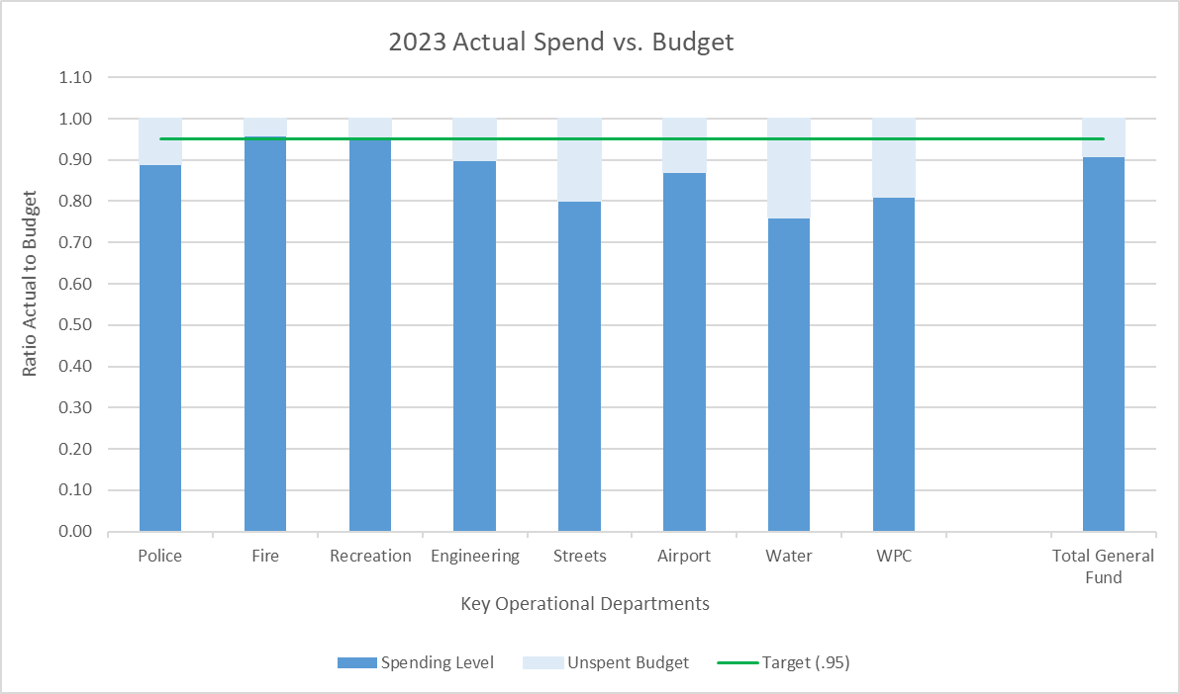
Dept. | ENTERPRISE
KPI Measure | Actual vs. Budget – YTD Ratios
Rationale/ Definition | We monitor the rate of spending as a ratio to the budget to try to stay below budget. The year-to-date (YTD) actual spend is compared to the pro-rated budget, based on a uniform spend assumption.
Frequency | Quarterly (YTD amounts at end of each quarter)
Data Source | Financial summary data
Graph
Other/ comments | Our target spending is a .95 level. This provides us with flexibility to allocate additional funds to capital improvements and/or increase cash reserves.

Slide 6
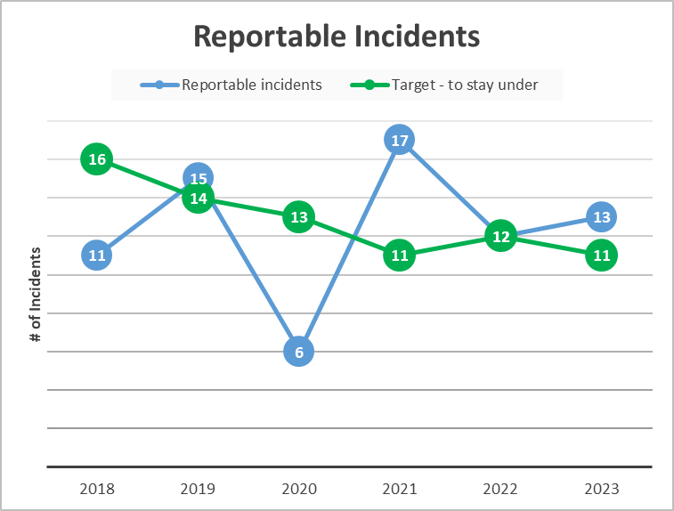
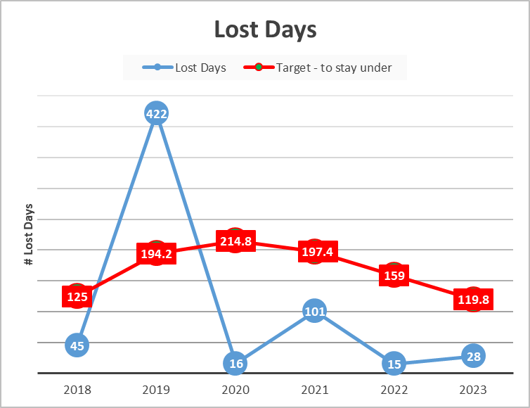
Dept. | ENTERPRISE | ENTERPRISE
KPI Measure | Safety: # of Reportable Incidents | Safety: # of Lost Days (due to injury)
Rationale/ Definition | Tracking the number of incidents each year allows us to examine trends and take steps to reduce injuries and accidents in the workplace. | The days lost due shows the cost and productivity that is lost due to injuries and accidents in the workplace.
Frequency | Quarterly | Quarterly
Data Source | Bureau of Workers Compensation data | Bureau of Workers Compensation data
Graph
Other/ comments | The target is a 10% reduction from the 5 year average; not to exceed the previous year’s target incidents. | The target is a 10% reduction from the 5 year average; not to exceed the previous year’s target incidents. In 2019, the majority of the lost days are attributed to 1-2 incidents.

Slide 7
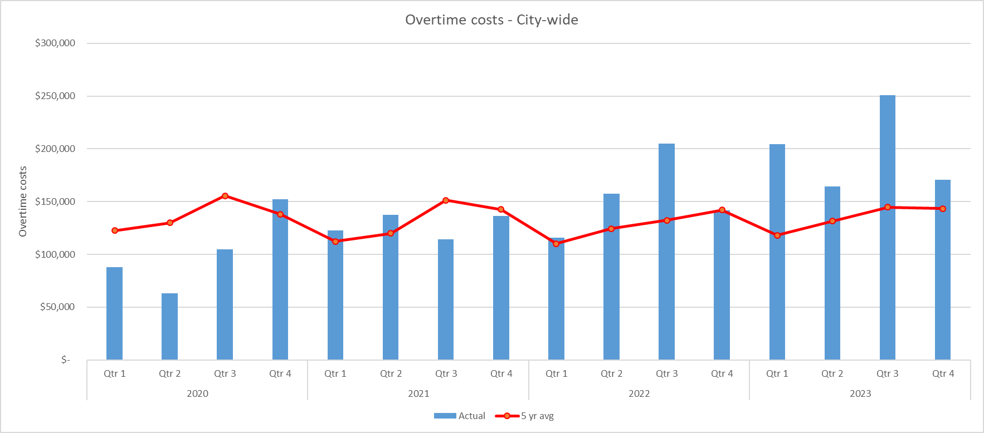
Dept. | ENTERPRISE
KPI Measure | Overtime
Rationale/ Definition | We monitor overtime costs by comparing to a 5-year quarterly average.
Frequency | Quarterly
Data Source | Overtime summary
Graph
Other/ comments | Our target for comparison is a 5-year average. Higher levels of overtime are generally caused by weather related events (e.g. flooding, snow, etc.) 2020: Overtime is high in the 4th quarter related to COVID-19 (sick time, quarantines) 2022: Overtime is high in the 2nd quarter due to multiple CRT callouts. 2023: Overtime is high due to staffing needs in the Police and Fire Departments. The City is actively hiring to remedy this.

Slide 8
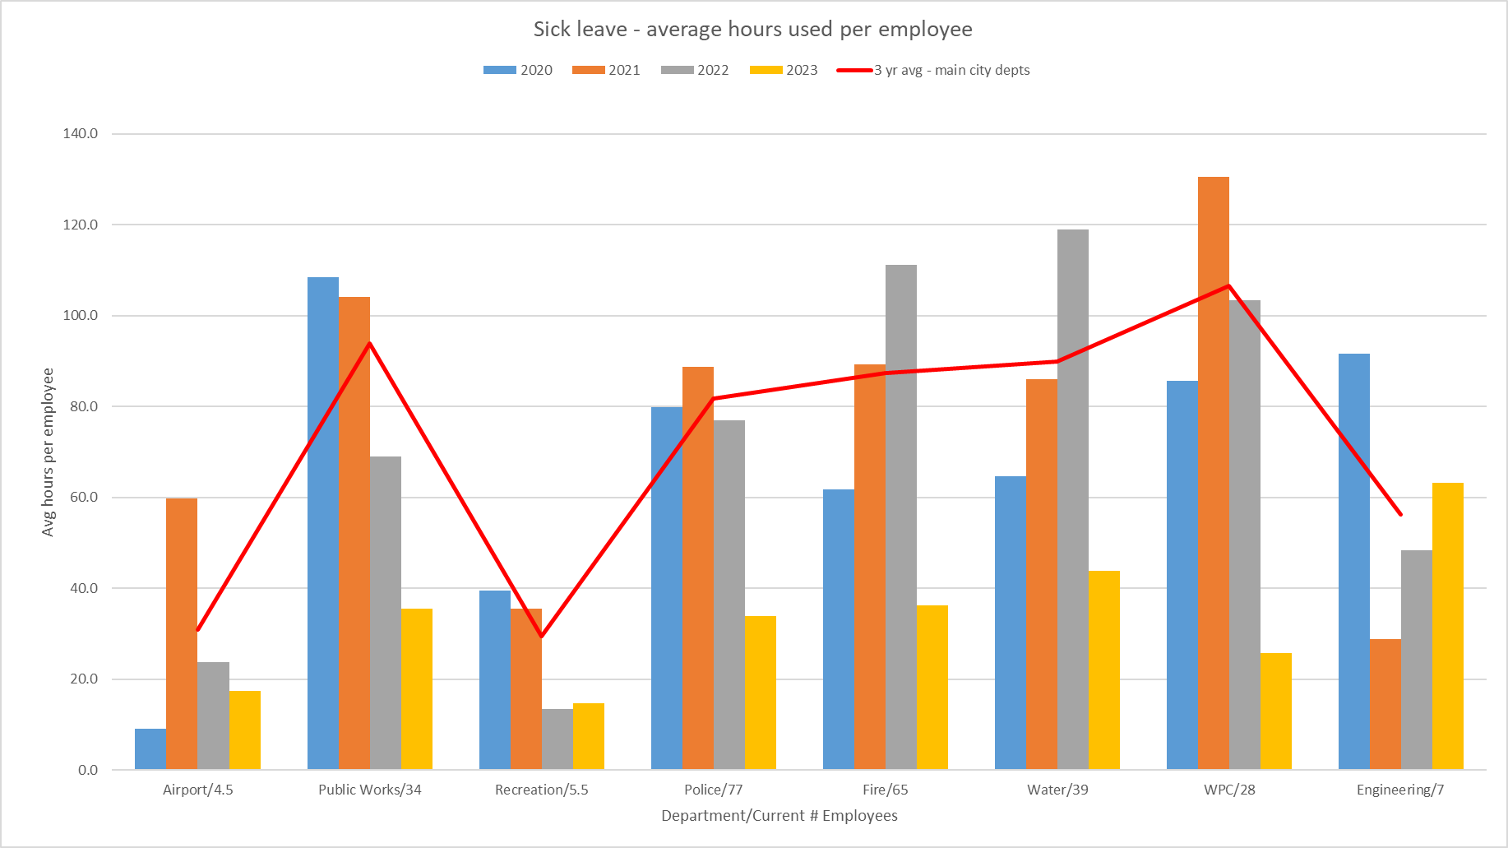
Dept. | ENTERPRISE
KPI Measure | Employee Sick Time Usage
Rationale/ Definition | We monitor sick time usage in order to curb any possible abuse. It is compared to a 3-year average.
Frequency | Biannually
Data Source | Sick time usage data
Graph
Other/ comments | Our target for comparison is a 3-year average. Sick leave can also include sick leave hours taken as part of FMLA. The Fire department usage is higher due to the 24 hr. shifts. This KPI is updated after the mid-year and end-of-year marks. 2020: Some departments have high usage related to FMLA leaves (such as maternity/paternity) and coronavirus related leaves.

Slide 9
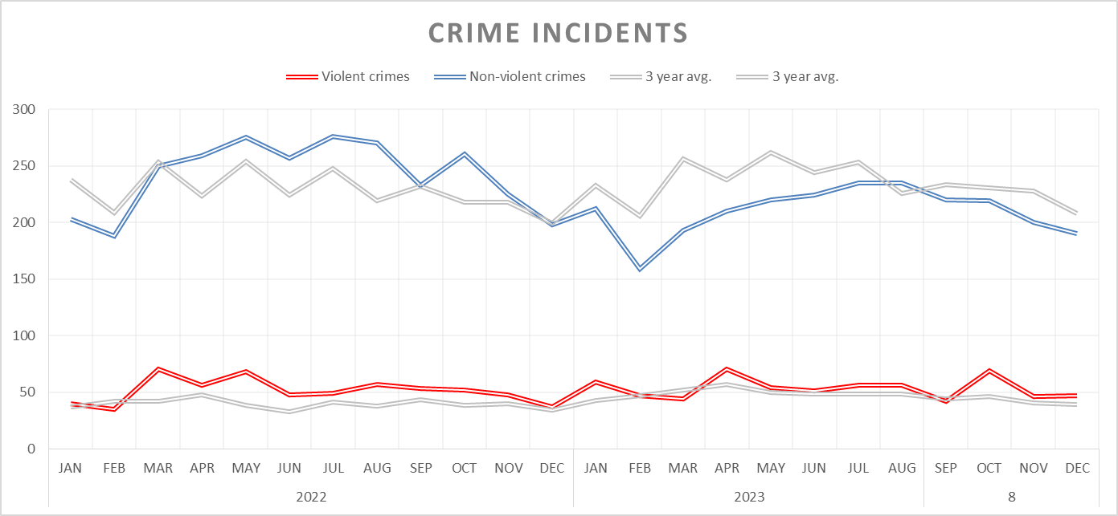
Dept. | POLICE
KPI Measure | # of Violent & Non-Violent Crimes
Rationale/ Definition | We monitor crime incidents as compared to a 3-year average in order to examine changing trends. Communities are evaluated on the number of non-violent and violent crimes committed in their jurisdiction. This measure allows us to prudently direct resources.
Frequency | Monthly
Data Source | Police Statistics
Graph
Other/ comments | Our target for comparison is a 3-year monthly average. Violent crimes include: homicide, rape, robbery, assault, sex offenses and aggravated assault. Non-Violent crimes include: unlawful entry, theft/fraud/shoplifting, motor vehicle theft, arson, criminal damage/vandalism, domestic dispute, and alcohol/drug Crime Incidents are running higher than the 3 year average. They appear higher due to the decrease experienced during the pandemic in 2020, as well as the transition to a new, more comprehensive, data collection system at the beginning of 2020. As we accumulate more data, the metrics will be adjusted accordingly.

Slide 10
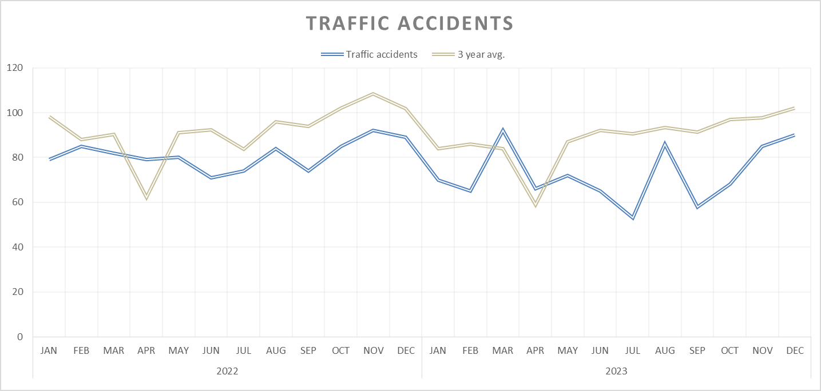
Dept. | POLICE
KPI Measure | # of Traffic Accidents
Rationale/ Definition | We monitor traffic accidents as compared to a 3-year average. This measure allows us to determine effective resource allocation to enforce laws related to motorists and pedestrians.
Frequency | Monthly
Data Source | Police Statistics
Graph
Other/ comments | Our target for comparison is a 3-year monthly average.

Slide 11
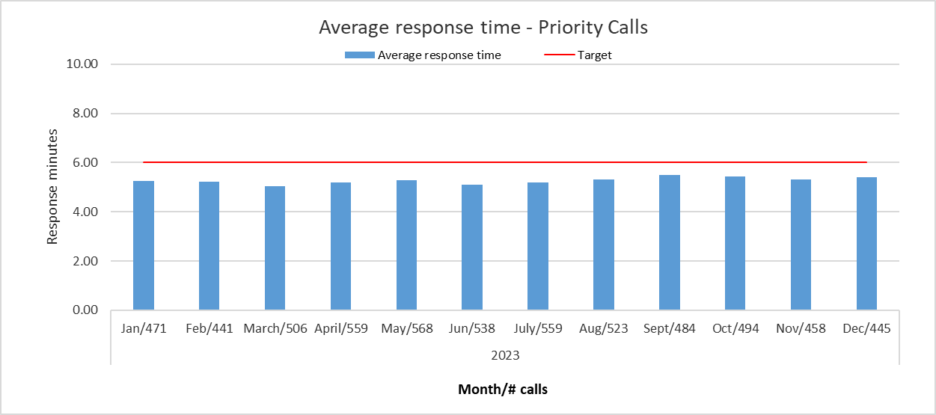
Dept. | POLICE
KPI Measure | Average response time – Priority Calls
Rationale/ Definition | Quick response times to emergency calls are key to police effectiveness. People expect the police to respond in a timely manner. That is why response times to emergency/in-progress calls are evaluated.
Frequency | Monthly
Data Source | CAD Incidents Unit Response Report
Graph
Other/ comments | Our target is 6 minutes. The target is based on prior year data and the desire to set an assertive, yet realistic goal.

Slide 12
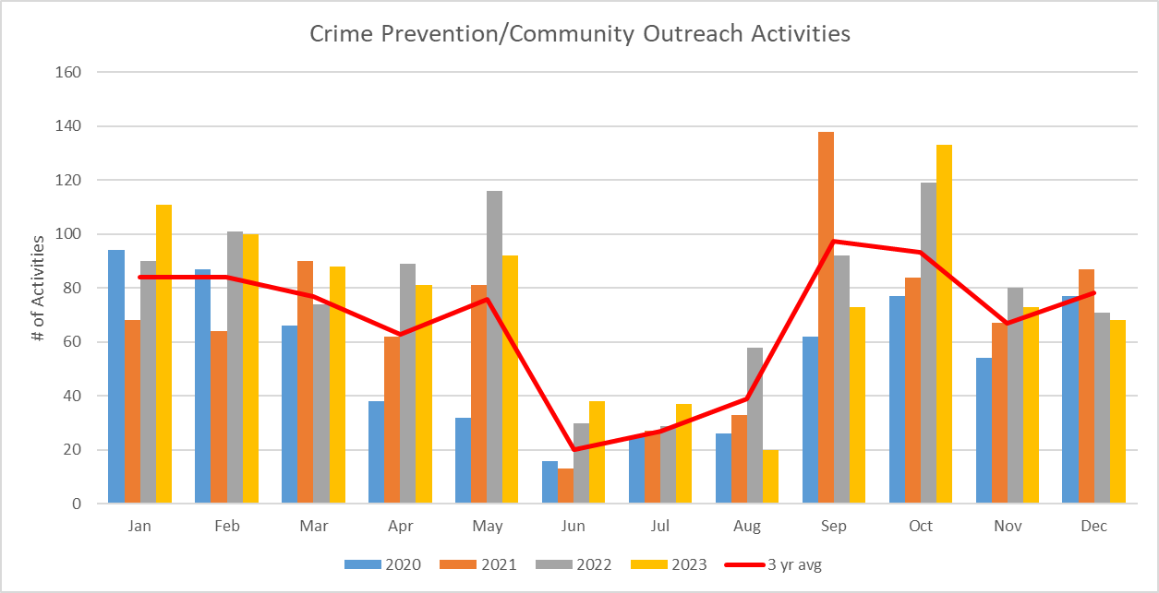
Dept. | POLICE
KPI Measure | Crime prevention and community outreach activities
Rationale/ Definition | The Crime Prevention/Community Outreaches are a vital aspect of the function of the Findlay Police Department. These include activities by the Crime Prevention Officer as well as school walk-throughs/visits by officers, in addition to any other outreach an officer does.
Frequency | Monthly
Data Source | Police Statistics
Graph
Other/ comments | We are comparing to the 3-year monthly average. These activities include: school visits, class presentations, school walk-throughs, Crime Stopper meetings, Block Watch meetings, Coffee with a Cop, etc. Activity is lower in the summer months due to school being out of session. 2020: Activity is low due to school being out of session related to COVID-19.

Slide 13
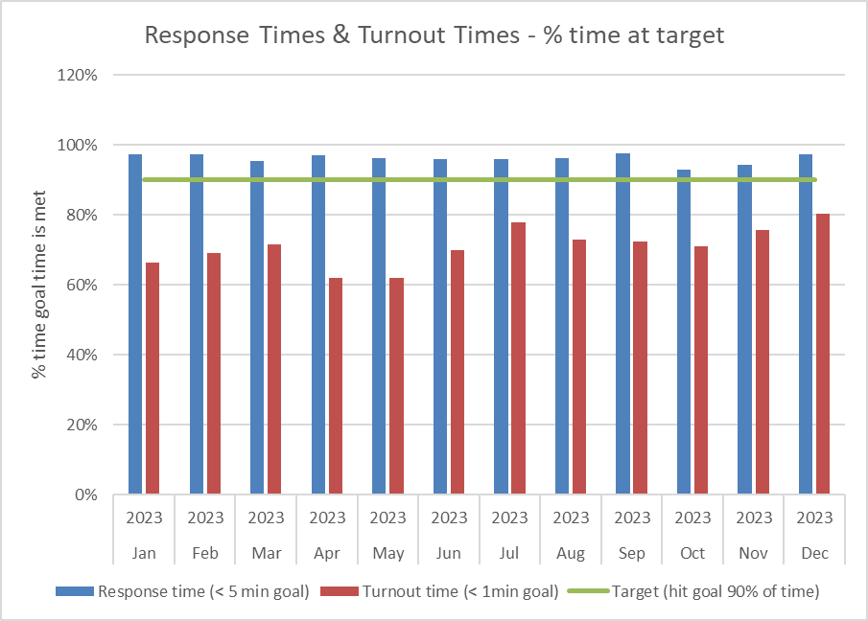
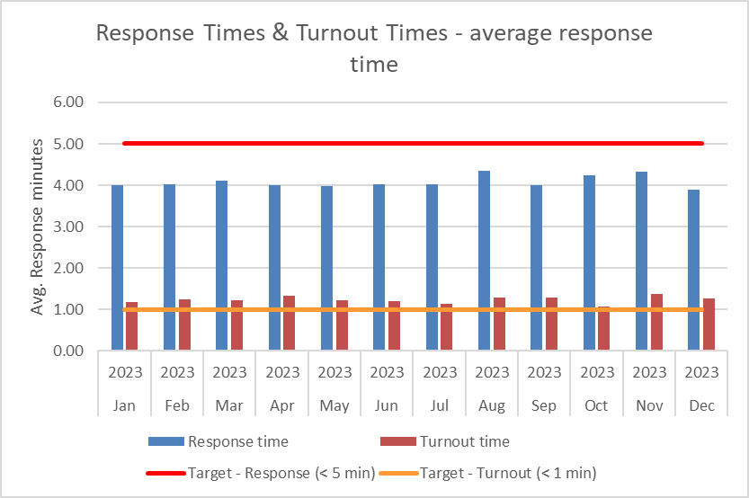
Dept. | FIRE | FIRE
KPI Measure | Response Time and Turnout Time | Average Response Time & Turnout Time
Rationale/ Definition | Quick response is vital to the effectiveness of the fire department. We strive to meet standards set by the NFPA (National Fire Protection Association). | We also monitor our average response times to examine trends and identify efficiency areas to be addressed.
Frequency | Monthly | Monthly
Data Source | Response Time Breakout Summary | Response Time Breakout Summary
Graph
Other/ comments | Response time goal: To arrive on scene in less than 5 minutes on 90% of emergency calls. Turnout time goal: To be en route in less than 1 minute on 90% of emergency calls. Response time: Time from alarm at station to arrival at scene Turnout time: Time from alarm at station to vehicle in motion to scene | Our target response time is less than 5 minutes. Our target turnout time less than 1minute. Response time: Time from alarm at station to arrival at scene Turnout time: Time from alarm at station to vehicle in motion to scene

Slide 14
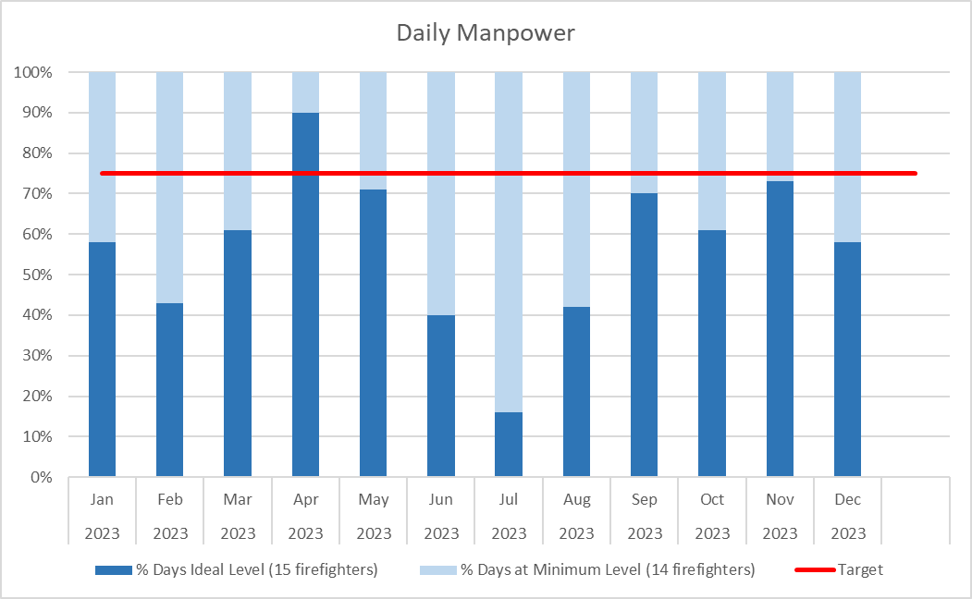
Dept. | FIRE
KPI Measure | Daily manpower level
Rationale/ Definition | Having the appropriate level of personnel on duty daily is key to the effectiveness of the fire department. The optimal level is 15 or more, which allows for a dedicated ladder truck company. The daily minimum level is 14. This number does not include fire prevention personnel or the Fire Chief.
Frequency | Monthly
Data Source | Fire Department
Graph
Other/ comments | The target for days at ideal level is 75%. Note: June & July one additional vacation slot is open. This drops the manpower to minimum most days.

Slide 15
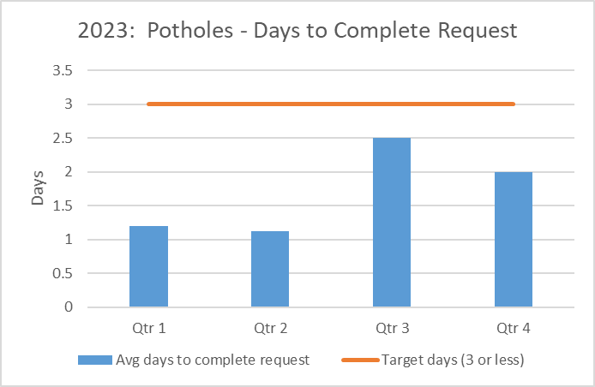
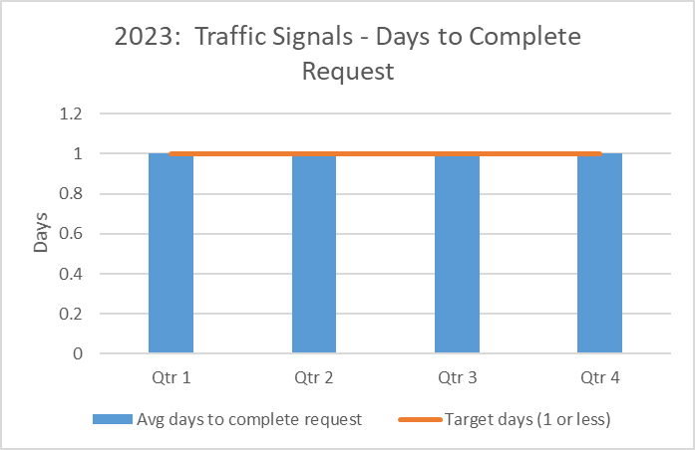
Dept. | PUBLIC WORKS | PUBLIC WORK5
KPI Measure | Potholes – Days to complete request | Traffic Signals – Days to complete request
Rationale/ Definition | We strive to respond to and repair reported problems in a timely manner. | We strive to respond to and repair reported problems in a timely manner.
Frequency | Monthly | Monthly
Data Source | Work order data | Work order data
Graph
Other/ comments | Target is 3 days or less. The quarterly average of number of pothole requests is 7. | Target is 1 day or less. The quarterly average of number of traffic signal requests is 9.

Slide 16
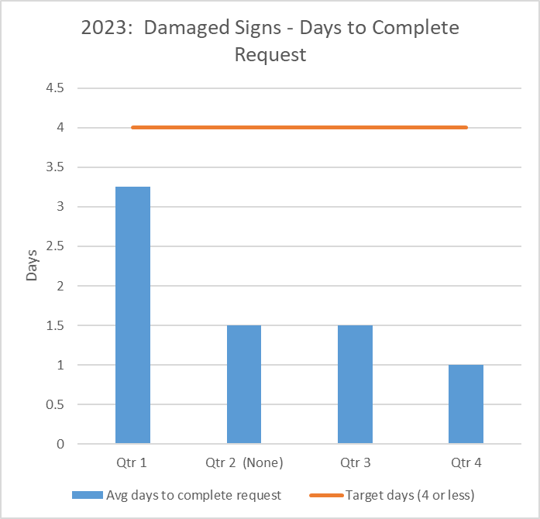
Dept. | PUBLIC WORKS
KPI Measure | Damaged signs – Days to complete request
Rationale/ Definition | We strive to respond to and repair reported problems in a timely manner.
Frequency | Monthly
Data Source | Work order data
Graph
Other/ comments | Target is 4 days or less. The quarterly average number of sign repairs is 3.3. Note: If digging is needed to replace a sign, there is a 2 day wait for an OUPS check.

Slide 17
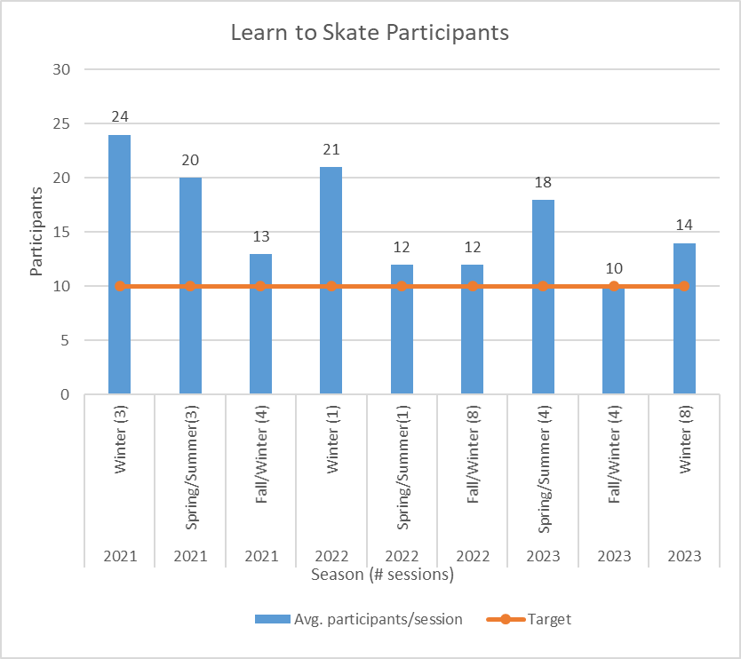
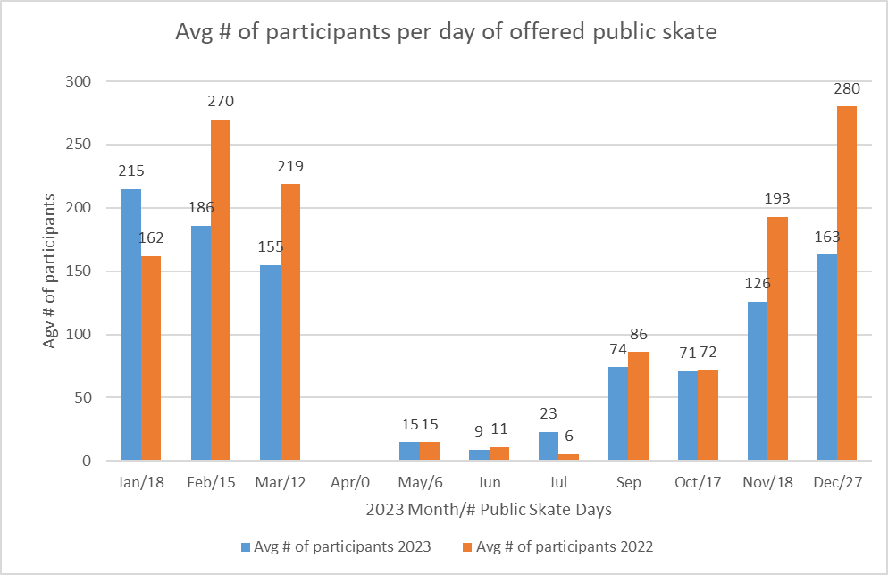
Dept. | RECREATION | RECREATION
KPI Measure | Average # of participants per day of offered public skate | “Learn to Skate” program participants
Rationale/ Definition | To measure level of participation in our offered programs. | To measure level of participation in our offered programs
Frequency | Monthly | Seasonally
Data Source | Recreation department data | Recreation department data
Graph
Other/ comments | No public skate offered in April due to dry floor events.

Slide 18
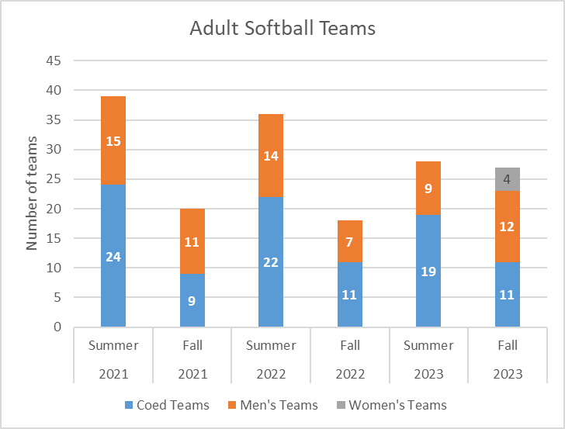
Dept. | Recreation
KPI Measure | # Teams – Adult Softball
Rationale/ Definition | To measure level of participation in our offered programs.
Frequency | Seasonally
Data Source | Recreation department data
Graph
Other/ comments | Women’s softball teams are new as of Fall 2023.

Slide 19
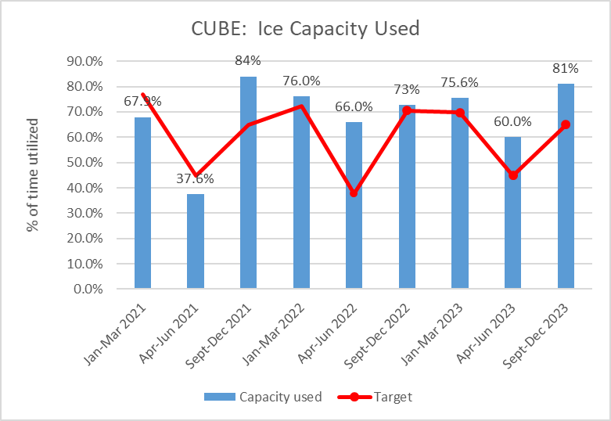
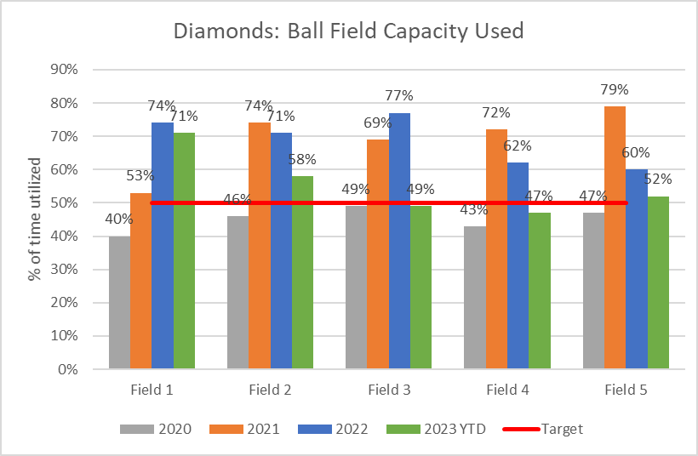
Dept. | RECREATION | RECREATION
KPI Measure | Ice capacity used at the Cube | Ball field capacity used at the Diamonds
Rationale/ Definition | To measure the level of use of our facilities. | To measure the level of use of our facilities.
Frequency | Seasonally | Seasonally
Data Source | Recreation department data | Recreation department data
Graph
Other/ comments | Our target varies depending on the season. The floor is also used for dry floor events from April – August each year. 2021: No events 2021: Implemented a new scheduling software in mid 2021 and comparable usage data is not yet available. 2022: Using formula to show the use age of available hours of facility vs. 24 hr period. | Our target is 50% utilization. Fields 4 & 5 not open for use in Q1 2023. 2020: Activities lower due to COVID-19.

Slide 20
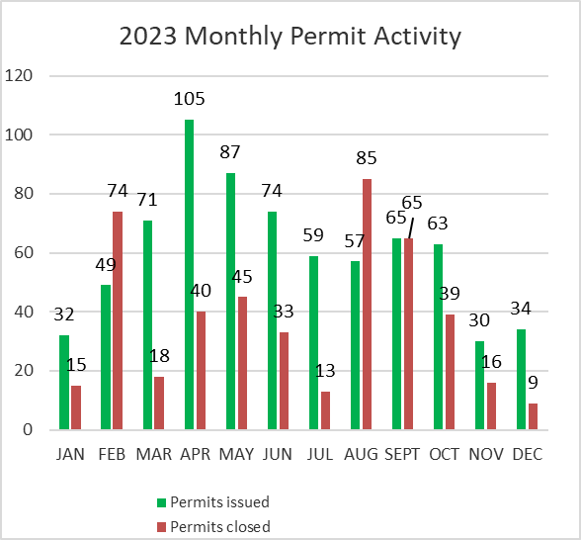
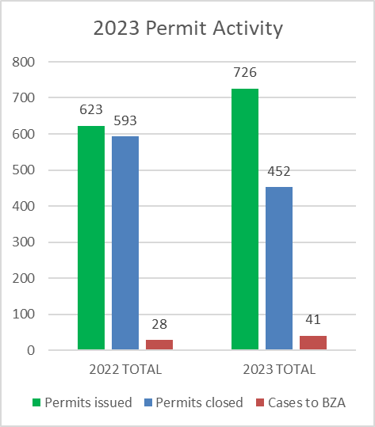
Dept. | ZONING
KPI Measure | Permit activity – Number of permits issued, closed, or submitted to the Board of Zoning Appeals (BZA) each month.
Rationale/ Definition | To measure level of permit activity in the Zoning area.
Frequency | Monthly
Data Source | Zoning department data
Graph
Other/ comments | The Zoning Office handles all permits related to a change of use, new construction and floodplain management. Many types of construction require a permit including, but not limited to: fences, sheds, decks, signs, dwellings and grading. If a permit does not comply with the zoning code, it may be taken to the BZA for disposition.

Slide 21
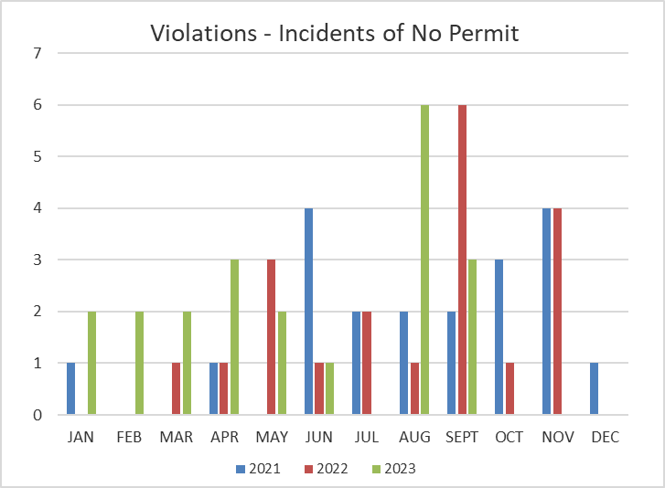
Dept. | ZONING
KPI Measure | Permit violations – incidents discovered without a permit.
Rationale/ Definition | To monitor permit violations and how they are addressed.
Frequency | Monthly
Data Source | Zoning department data
Graph
Other/ comments | Zoning strives to resolve violations by working on a solution so that a variance is not required.

Slide 22
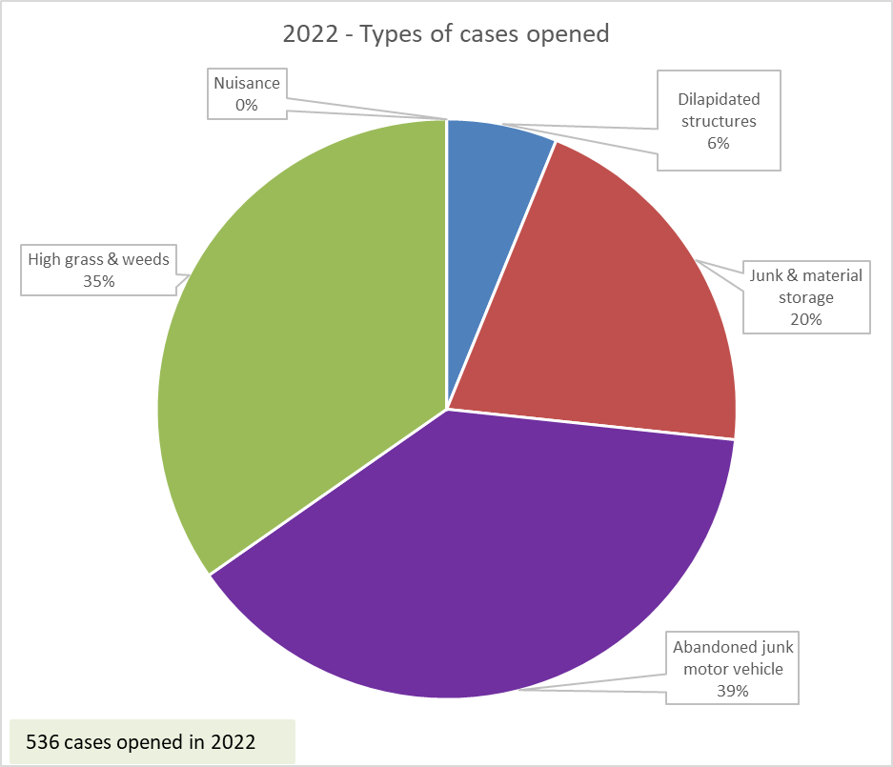
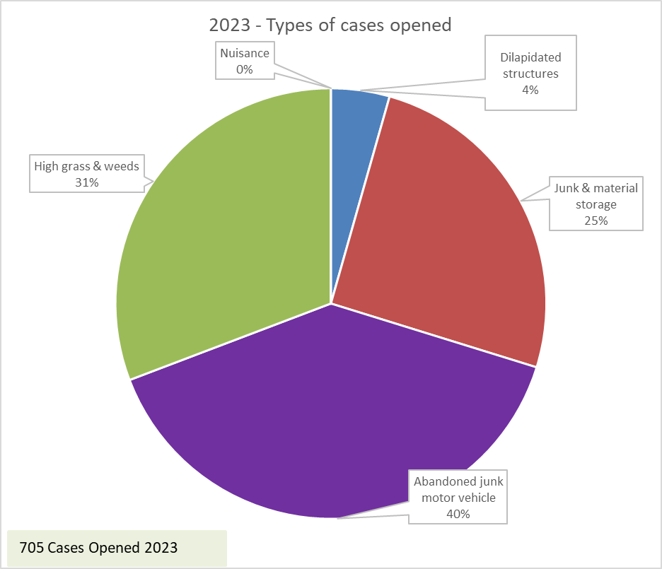
Dept. | ZONING ENFORCEMENT
KPI Measure | Zoning enforcement case activity – types of cases opened.
Rationale/ Definition | To measure the volume and nature of issues occurring.
Frequency | Monthly
Data Source | Zoning department data
Graph
Other/ comments

Slide 23
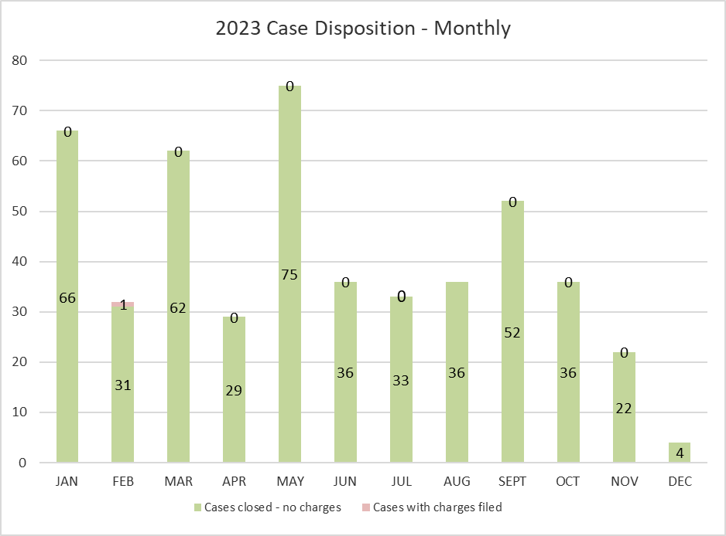
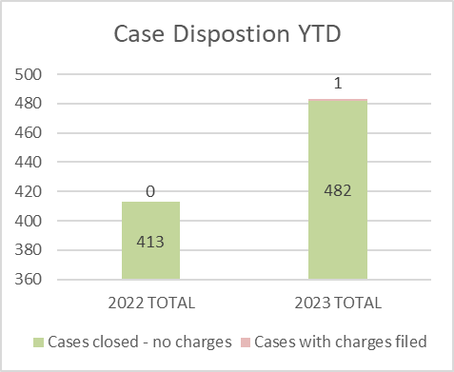
Dept. | ZONING ENFORCEMENT
KPI Measure | Case Disposition
Rationale/ Definition | To monitor cases and how they are resolved.
Frequency | Monthly
Data Source | Zoning department data
Graph
Other/ comments | Zoning strives to resolve violations by working with property owners towards voluntary compliance and avoiding charges. If voluntary compliance is not reached, charges are filed.

Slide 24
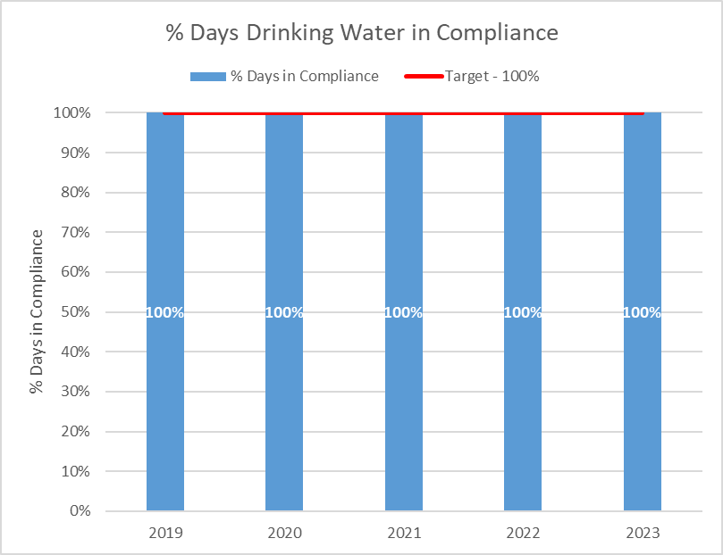
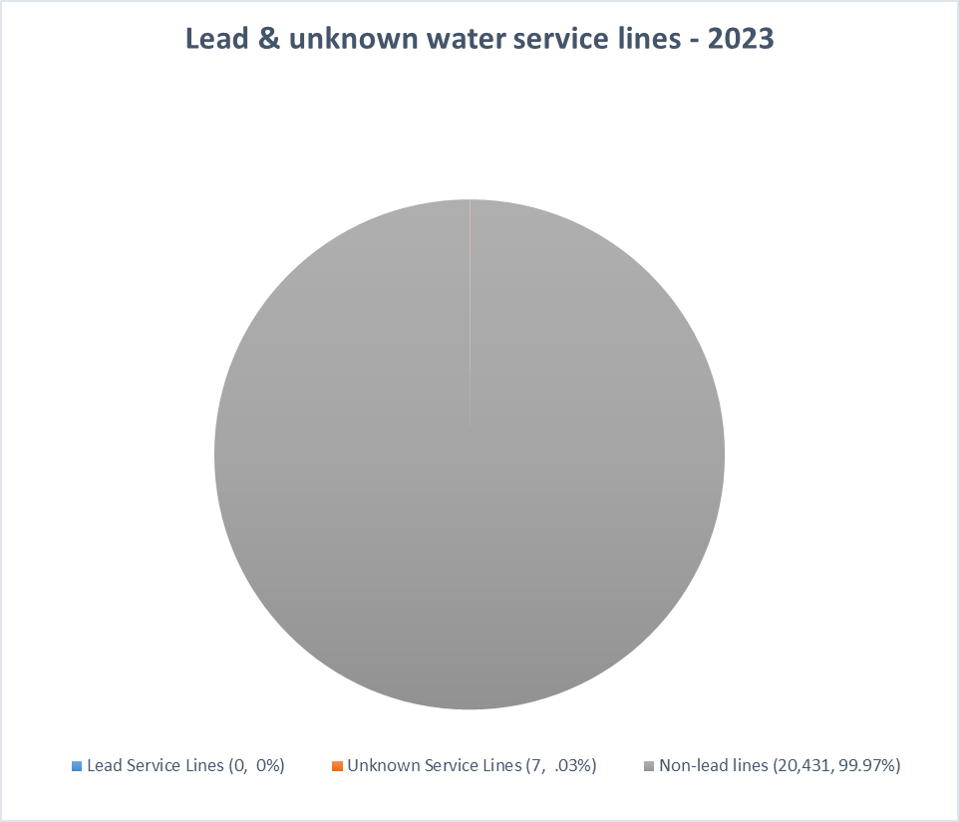
Dept. | WATER DEPARTMENT | WATER DEPARTMENT
KPI Measure | % Days Drinking Water is in Compliance | Identification of Lead and Unknown Water Service Lines
Rationale/ Definition | This is used to measure the quality of our water, as well as compliance with regulatory requirements of the State of Ohio EPA. | To track our identification of lead service lines.
Frequency | Quarterly | Annually
Data Source | Water Department Data | Water Department Data
Graph
Other/ comments | Our target is 100%. We meet or exceed the regulatory requirements which include, but are not limited to, lead and copper levels. | Our ongoing objective is to reduce the number of Lead & Unknown service lines. Lead service lines were reduced from 54 in 2019, to 45 in 2020, to 41 in 2021, to 0 in 2023. Because of our stability and high water quality, we inspect the water lines as projects occur. (i.e. when a street is being torn up for a project, we take that opportunity to inspect the lines.)

Slide 25
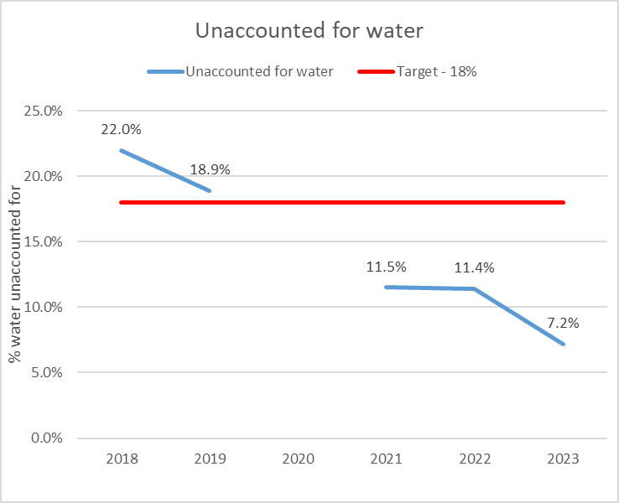
Dept. | WATER DEPARTMENT
KPI Measure | Unaccounted for Water
Rationale/ Definition | To monitor water that is unaccounted for and/or non-revenue producing.
Frequency | Monthly
Data Source | Water Department Data
Graph
Other/ comments | All water systems have a % of water that goes unbilled – this can be due to: unavoidable leakage, use by fire department, water meter inaccuracies, unauthorized consumption, etc. The water department actively monitors and analyzes this. Note: During 2020, the Water Department worked to identify sources of water loss and analyze the related computations. Because of inconsistencies in the data, we did not maintain/report this KPI in 2020. We are continually working to identify areas to investigate further and remediate appropriately. These include: installing new meters at the water plant, continually evaluating flushing stations, and monitoring unmetered water usage in the system.

Slide 26
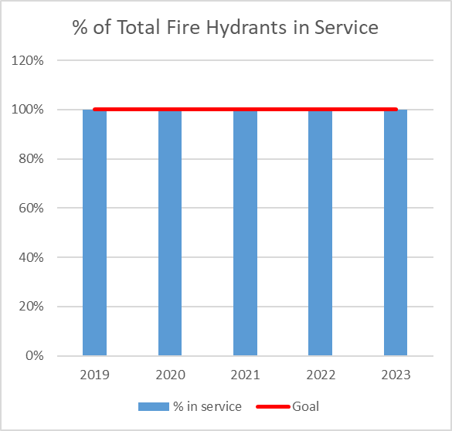
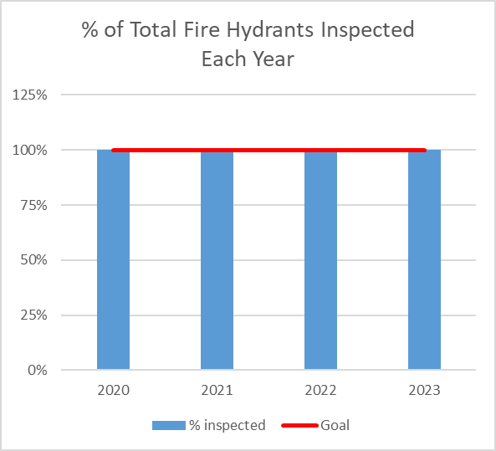
Dept. | WATER DEPARTMENT | WATER DEPARTMENT
KPI Measure | % of Total Fire Hydrants in Service | % of Fire Hydrants Inspected Each Year
Rationale/ Definition | To measure the level of service and usability of fire hydrants to make sure all are in good working order when needed. | To measure efforts to inspect and maintain fire hydrants. Inspections and flushing of hydrants is done to improve the quality and flow of the water.
Frequency | Quarterly | Quarterly
Data Source | Water Department Data | Water Department Data
Graph
Other/ comments | Our goal is to keep 100% of the fire hydrants in service. The City maintains approximately 2,580 fire hydrants. | All fire hydrants are inspected each year and therefore our goal is 100%.

Slide 27
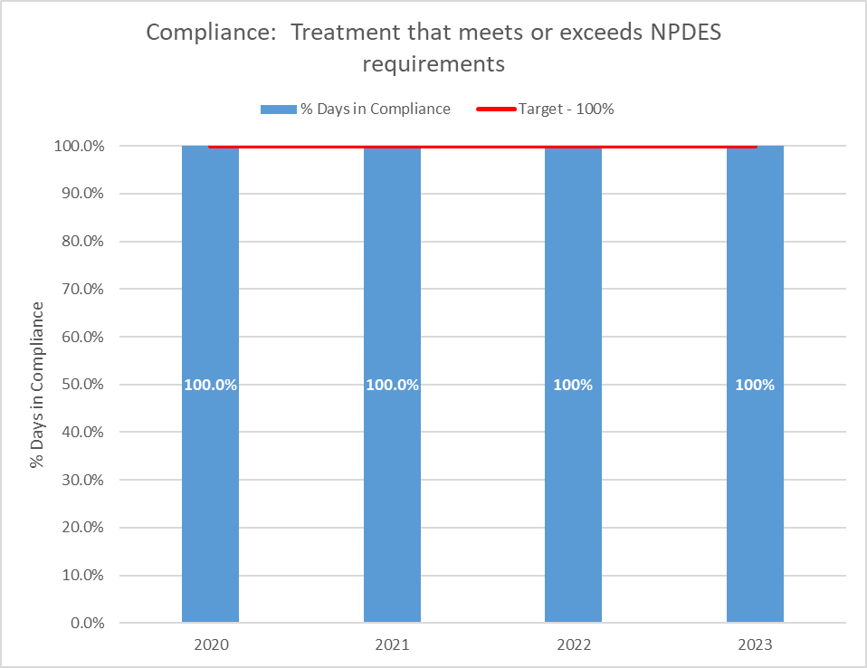
Dept. | WATER POLLUTION CONTROL | WATER POLLUTION CONTROL
KPI Measure | % Days in Compliance with NPDES requirements for treatment | % Days in Compliance with NPDES requirements for reporting
Rationale/ Definition | Ensure a final effluent quality for compliance with requirements specified by the U.S. EPA and the Ohio EPA. | To comply with monthly reporting – completing and submitting Discharge Monitoring Reports to the Ohio EPA.
Frequency | Quarterly | Quarterly
Data Source | WPC Department data | WPC Department data
Graph
Other/ comments | Our target is 100% NPDES – National Pollutant Discharge Elimination System The City Of Findlay Wastewater Treatment Plant provides wastewater treatment of residential, commercial and industrial wastewater. The Wastewater Treatment Plant treats on average four (4) billion gallons a year. | Our target is 100% NPDES – National Pollutant Discharge Elimination System

Slide 28
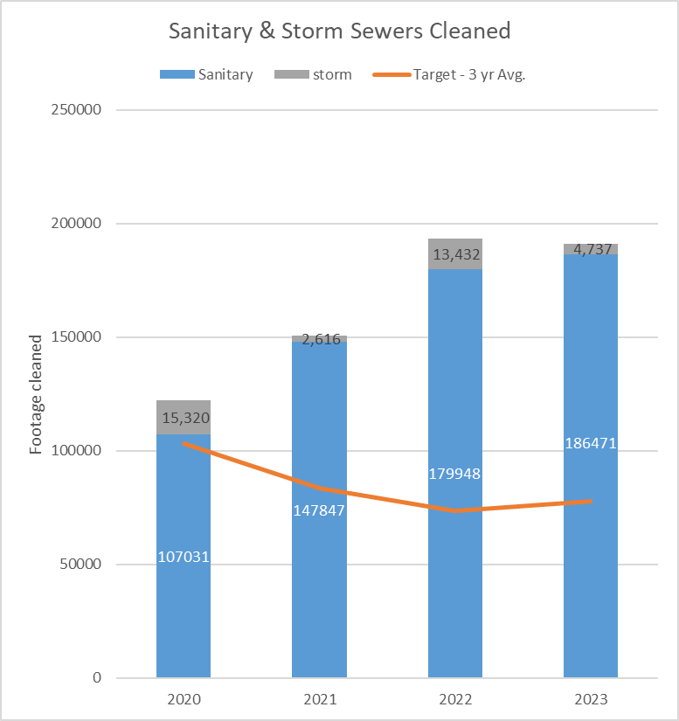
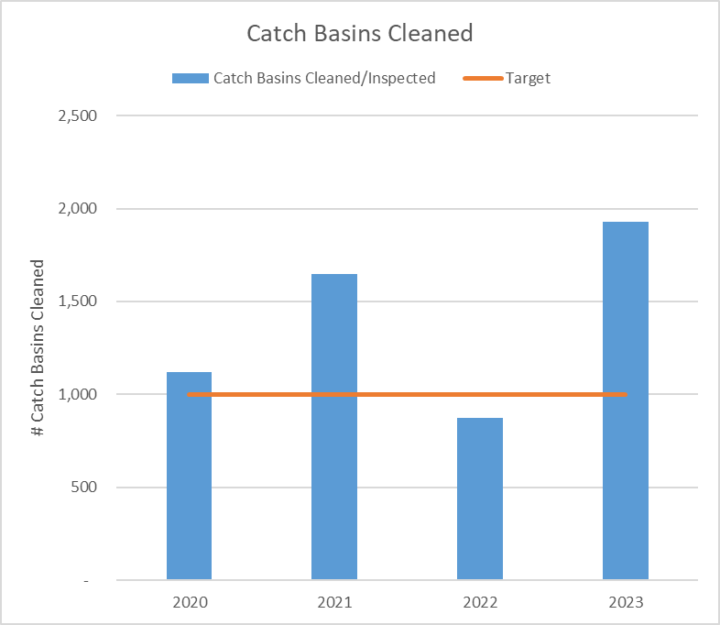
Dept. | WATER POLLUTION CONTROL | WATER POLLUTION CONTROL
KPI Measure | Footage of Sanitary & Storm Sewers Cleaned | Catch Basins Cleaned
Rationale/ Definition | To ensure we maintain our infrastructure and keep it working consistently and properly. | To ensure we maintain our infrastructure and keep it working consistently and properly.
Frequency | Quarterly | Quarterly
Data Source | WPC Department data | WPC Department data
Graph
Other/ comments | The sanitary sewer system has over 17,000 customers and is estimated to consist of over three hundred (300) miles of sanitary sewer, several thousand manholes and approximately six thousand four hundred (6,400) catch basins. It is imperative to maintain these systems for proper drainage – especially in times of rain events. Catch Basins cleaned in 2020 & 2021 adjusted to reflect updated tracking system adopted in 2022.

Slide 29
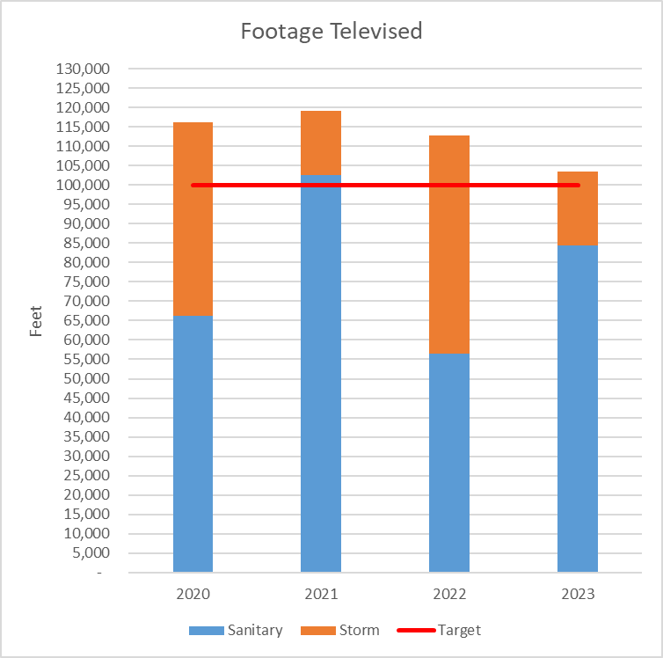
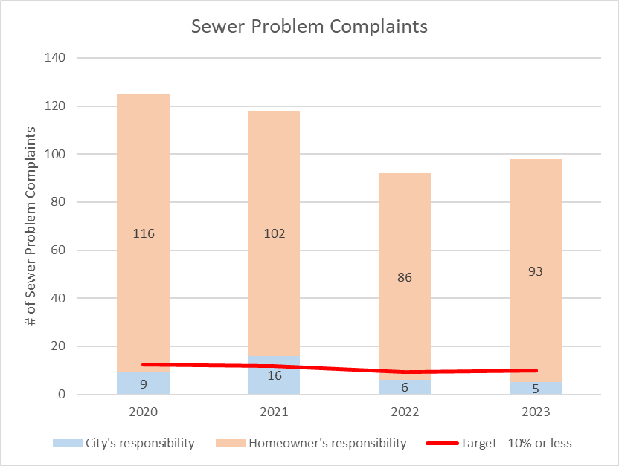
Dept. | WATER POLLUTION CONTROL | WATER POLLUTION CONTROL
KPI Measure | Footage of Sanitary & Storm Sewer Lines Televised | Sewer Problem Complaints - % that are the responsibility of the City
Rationale/ Definition | To ensure we maintain our infrastructure. We televise lines to ensure flow capacity and assess the need for repairs & maintenance. | To ensure we maintain and repair our infrastructure and swiftly address problems that are our responsibility.
Frequency | Quarterly | Quarterly
Data Source | WPC Department data | WPC Department data
Graph
Other/ comments |  | Our target is for sewer complaints to be the City’s responsibility no more than 10% of the time. A homeowner’s private line begins a the point of connection to the sewer main.
 | The sanitary sewer system has over 17,000 customers and is estimated to consist of over three hundred (300) miles of sanitary sewer, several thousand manholes and approximately six thousand four hundred (6,400) catch basins.

Slide 30
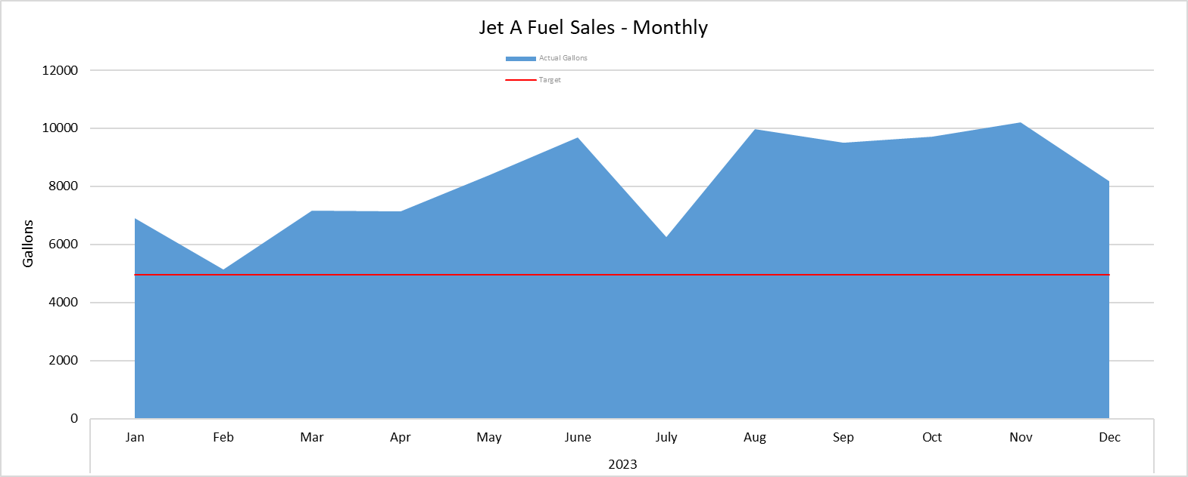
Dept. | AIRPORT
KPI Measure | Jet A Fuel Sales
Rationale/ Definition | Fuel sales are the largest revenue stream for the airport, especially the sale of Jet A.
Frequency | Monthly
Data Source | Jet A Fuel Sales Data
Graph
Other/ comments | The target is based on a review of average growth rate on the last 10 years of sales data and represents a 3% increase from 2019 sales. The airport facilitates a high volume of corporate aircraft traffic, which primarily purchases Jet A fuel.

Slide 31
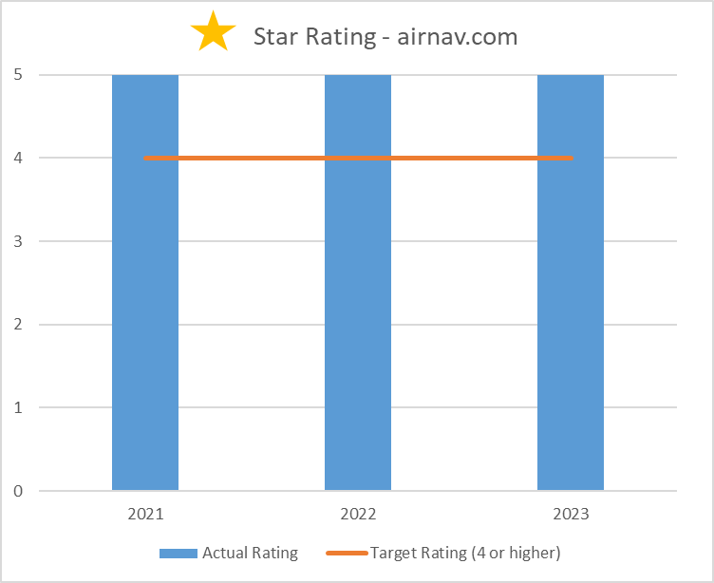
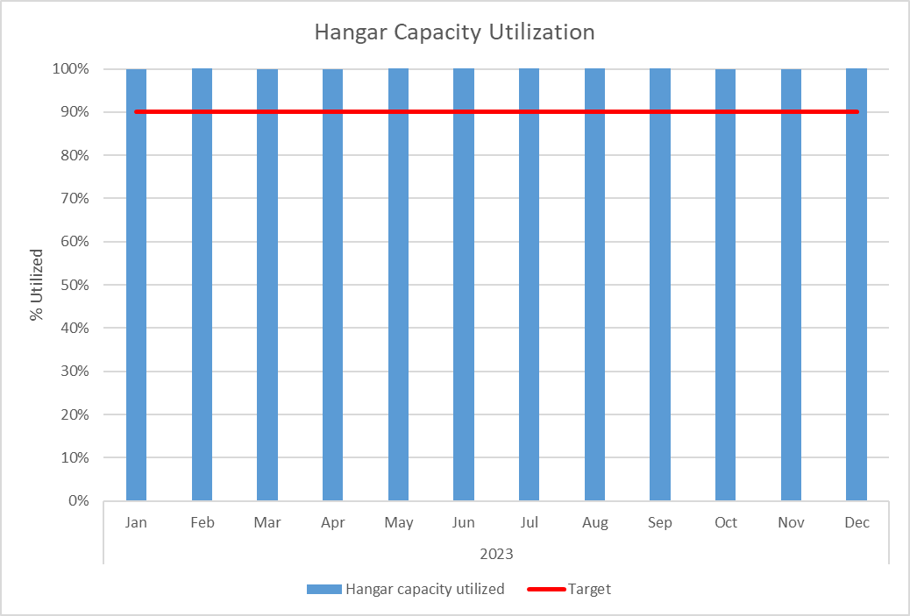
Dept. | AIRPORT | AIRPORT
KPI Measure | Hangar Capacity Utilized | Star Rating – airnav.com
Rationale/ Definition | To monitor the management of this revenue-generating asset. | Feedback from our customer base is an important way of measuring the level of service we offer.
Frequency | Monthly | Quarterly
Data Source | Airport Director | Airport Director/airnav.com website
Graph
Other/ comments | Our target is 90% capacity utilized. The airport owns and maintains twenty-five hangars, with varying size and capacity. Monthly rental income provides a solid revenue stream for operations. | AirNav.com is a website that contains airport information, including the entities on the airport that offer FBO services. Users are able to rate and review The City of Findlay Airport (FBO) for other potential customers to see. Along with written reviews, users are able to give a 1-5 star rating. Our target is a 4 star rating or higher.

Slide 32
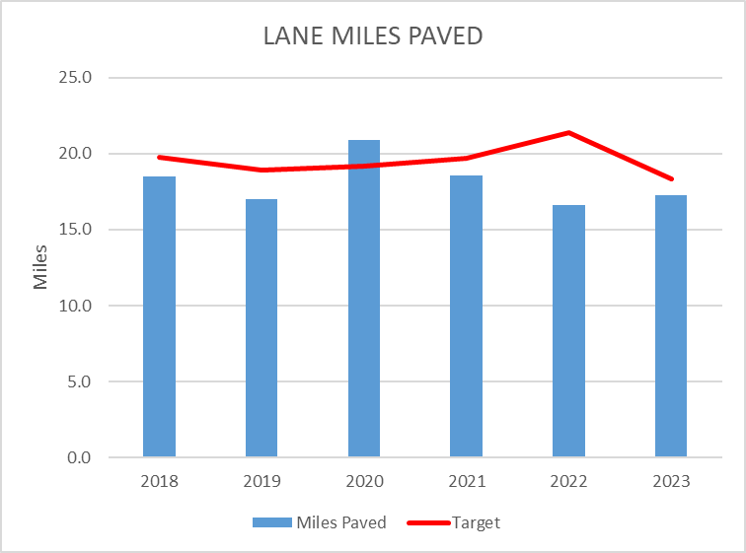
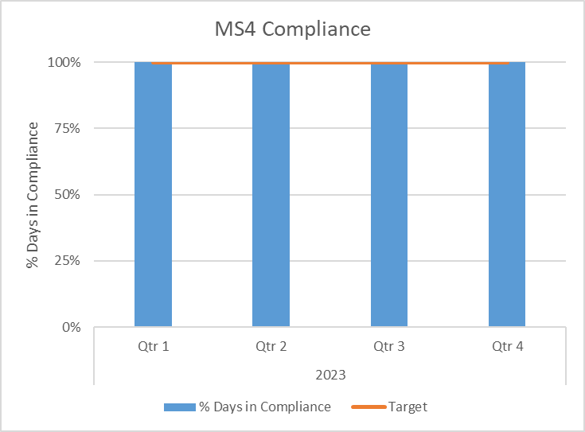
Dept. | ENGINEERING | ENGINEERING
KPI Measure | Lane miles paved | MS4 Compliance
Rationale/ Definition | Lane miles paved measures our progress in street maintenance and improvements. | MS4 relates to our adherence to certain USEPA standards.
Frequency | Annually | Quarterly
Data Source | City Engineer | City Engineer
Graph
Other/ comments | The lane miles paved each year is based on projects in the Capital Plan and availability of other funding sources in a given year. Data for 2020 is increased due to Safety, ODOT, and CDBG/OPWC funds being awarded. The target is the 5 year average of miles paved. The number does not include alleys that were paved. Data for 2017 used in creating targets is an outlier due to ODOT performing Urban Paving. | Our target is 100% compliance. MS4 stands for Municipal Separate Storm Sewer System. The MS4 standards relate to storm water runoff, erosion, and water quality. It is to protect surface water such as Blanchard River, Eagle Creek, etc.

Slide 33
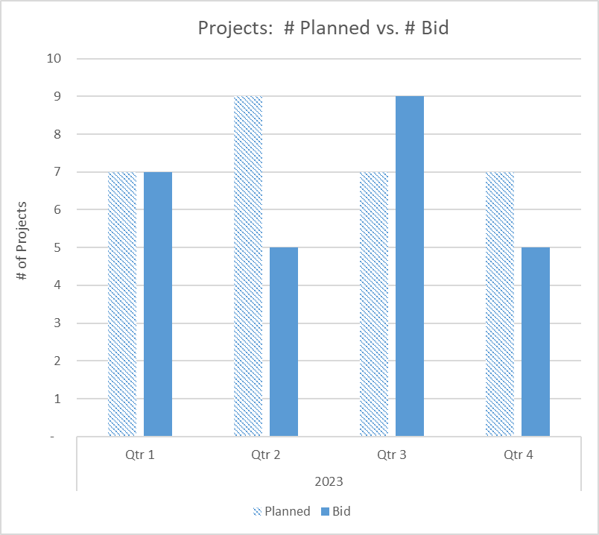
KPI Measure | Projects: # Planned vs. # Bid
Rationale/ Definition | This measure shows our ability to be pro-active and get planned projects out to bid timely.
Frequency | Quarterly
Data Source | City Engineer
Graph
Other/ comments | We develop and follow a 5-year capital plan (revised annually) which includes multiple year grants, etc. Each year the projects are planned by quarter based on nature of the project and to obtain optimal pricing.

Slide 34
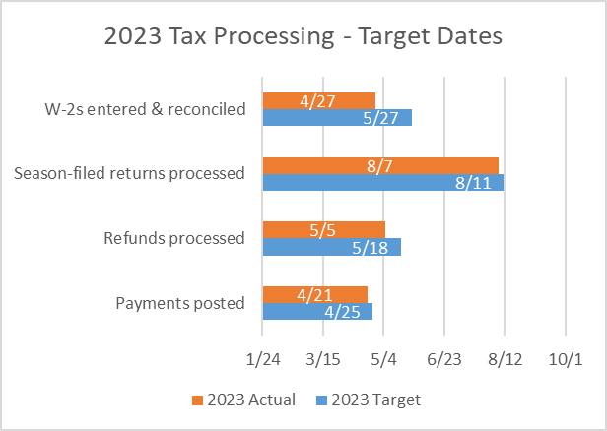
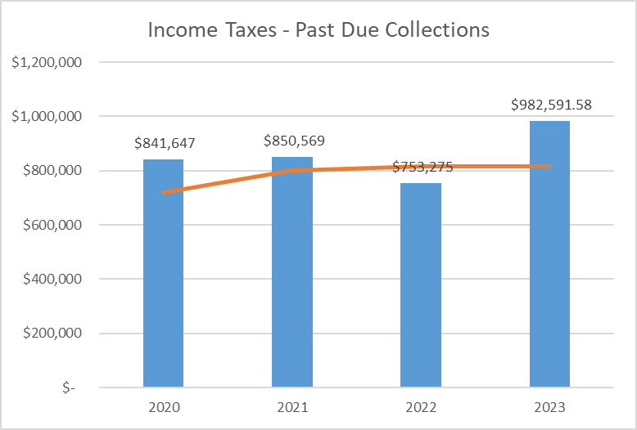
Dept. | TAX | TAX
KPI Measure | Processing Time | Past Due Collections
Rationale/ Definition | Processing efficiency is a key element of a productive tax department. | We continually pursue and monitor past due accounts to maximize collection of past-due taxes.
Frequency | Annually | Monthly
Data Source | Tax Administrator | Tax Administrator
Graph
Other/ comments | Target due dates are set at the beginning of the year for major processing tasks related to that year’s tax collections. | Trendline is based on a 3 year average.

Slide 35
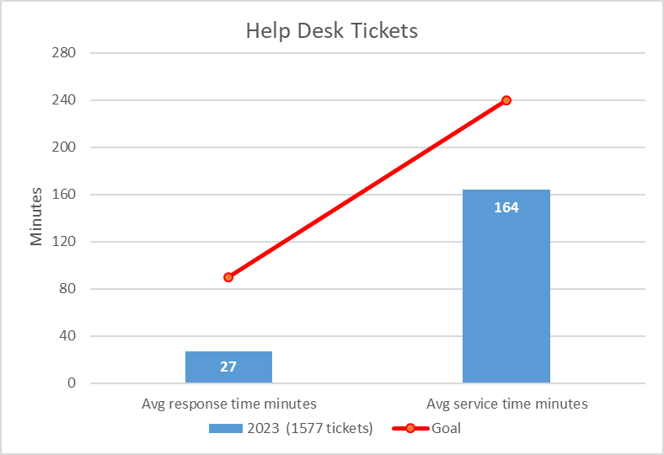
Dept. | COMPUTER SERVICES
KPI Measure | Help Desk Tickets: Average response time and average service time
Rationale/ Definition | Tracking response and service times measures our efficiency and ability to resolve issues in a timely fashion, thereby minimizing any loss of employee productivity.
Frequency | Monthly
Data Source | Help Desk Ticket System
Graph
Other/ comments | The target is to respond to and resolve issues in less than 240 minutes (4 hours). Response time is: ticket submission → first response; and service time is: ticket submission → problem resolution.

