Slide 1

Water Department
Rate adjustment proposal

Slide 2
Current Situation
The water department has not increased water rates since 2011
As water revenues have remained flat, expenses have increased 13% since 2012
In recent years major elimination of expenses (Capital and Operational) to maintain solvency
Experienced between 40 - 50% increase in 2022 for a majority of chemicals and has remained high
Capital outlook through 2031 for infrastructure improvements is anticipated to be in excess of $50M
  Masterplan
  Raw water line replacement and rehabilitation
  Emerging contaminant project
  Continued water line replacement
  System expansion based on demand – clear wells, towers, solids contact unit (SCU), etc.

Slide 3
Current Situation
According to the OEPA, Since 1997 Ohio municipalities as a whole have averaged nearly a 4% annual increase year over year
To maintain the existing high quality water plant and services, infrastructure requires routine preventative maintenance and capital improvements
Adjusting rates to align with the current market expense trajectory creates internal sustainability while also allowing for needed capital investment and long term set aside

Slide 4
Revenue / Expense Trend Comparison
2020 – 2022 Eliminated Expenses Based on Fund Position
$1,850,000 | Waterline Replacement
$150,000 | Postponed Vehicle Replacement
$250,000 | Reduction in Operating Budget
$2,000,000 | Raw Water line design and evaluation
$300,000 | Campus Sidewalk and Asphalt Repairs Held
$2,000,000 | Scheduled Plant /System Improvements Held
$80,000 | Reservoir FTE Position Held
$6,630,000 | TOTAL
Revenue Expense

Slide 5
OEPA – Findlay Average Bill Comparison
Ohio Average Findlay

Slide 6
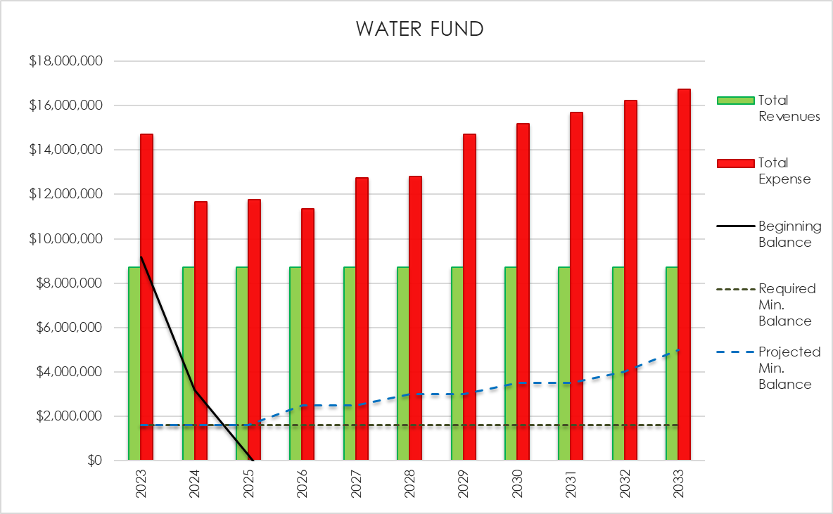

Slide 7
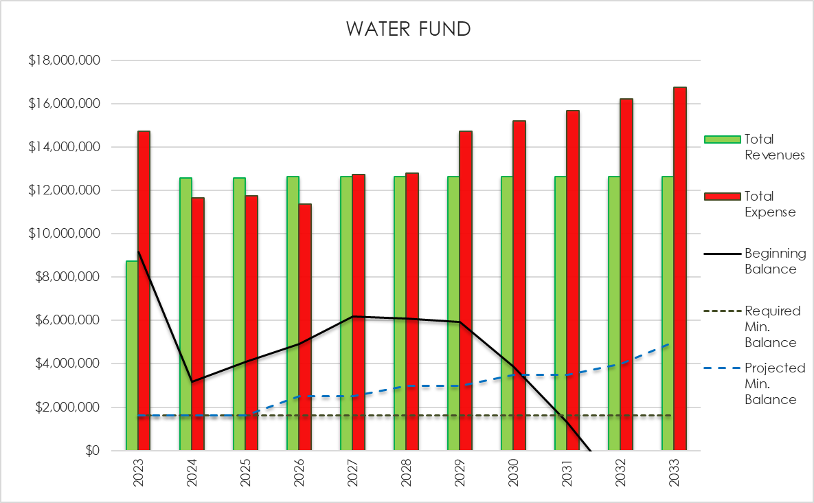

Slide 8
Monthly Residential Impact for Inside Users = 90% of Consumers
5/8” Meter | Monthly Impact | Annual Impact
Minimum Usage | $4.24 | $50.88
Family of 3 | $11.61 | $139.32
Family of 6 | $21.66 | $259.92
3/4” Meter | Monthly Impact | Annual Impact
Minimum Usage | $5.03 | $60.36
Family of 3 | $12.40 | $148.80
Family of 6 | $22.45 | $269.40
1” Meter | Monthly Impact | Annual Impact
Minimum Usage | $6.61 | $79.32
Family of 3 | $13.98 | $167.76
Family of 6 | $24.03 | $288.36

Slide 9
Monthly Residential Impact for Outside Users
5/8” Meter | Monthly Impact | Annual Impact
Minimum Usage | $6.36 | $76.32
Family of 3 | $17.42 | $209.04
Family of 6 | $32.49 | $389.88
3/4” Meter | Monthly Impact | Annual Impact
Minimum Usage | $7.55 | $90.60
Family of 3 | $18.60 | $223.20
Family of 6 | $33.68 | $404.16
1” Meter | Monthly Impact | Annual Impact
Minimum Usage | $9.92 | $119.04
Family of 3 | $20.97 | $251.64
Family of 6 | $36.05 | $432.60

Slide 10
Future Considerations
Annual review of water fund to determine solvency:
  Operational cost variability in relation to revenues
  Ensuring the minimum reserve balance aligns with operational cost projections
  Ongoing evaluation of capital needs for maintenance of current infrastructure and system growth demand
  Paying cash for projects vs. securing debt for large projects
  Minor annual rate increases vs. “As needed” reconciliation
  Short term priorities while positioning the Water Department for long term sustainability
    Prioritizing the Master Plan

Slide 11
Prioritizing the Master Plan
Short Term Plant improvements:
  Addition of Aeration in tower and clear wells for TTHM (Total Trihalomethane) removal
  Rehabilitation of SCU#1 (Solid Contact Unit)
  Addition of a lime press to solids handling
  Sand Filters Rebuild/ Rehabilitation
  Cleaning and inspection of 1M gallon raw water tank in front of plant
  Cleaning of emergency line to Riverside Park
Long Term Considerations:
  Second Raw Water Line
  Additional Water Tower(s)
  Addition of GAC (Granular Activated Carbon) /Ion exchange for advanced treatment
  Addition of second VFD (Variable Frequency Drive) high service pump for efficiency
  Additional Clearwell for Finished water

Slide 12
Questions

Slide 13
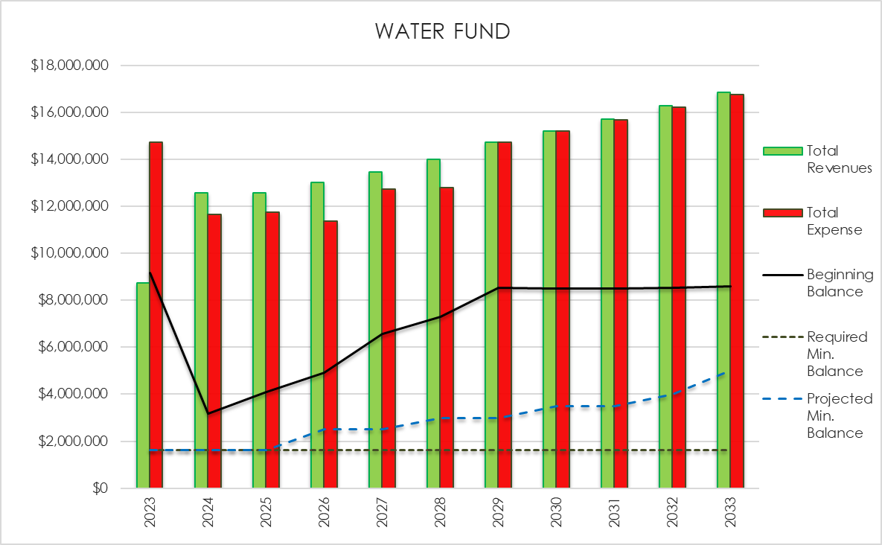
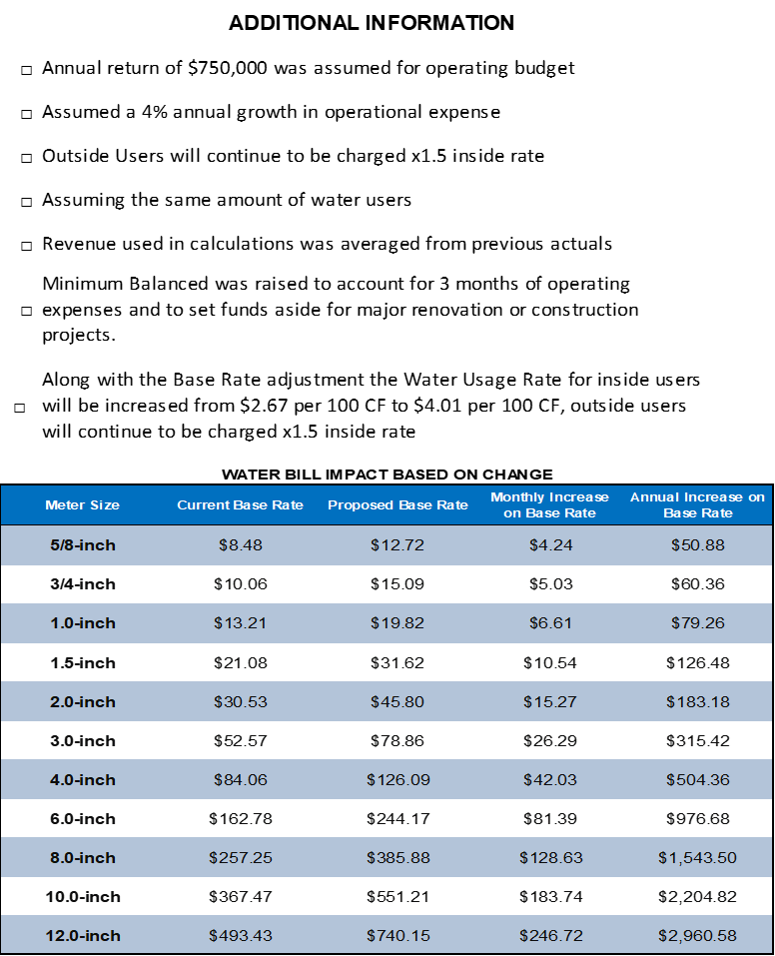

Slide 14
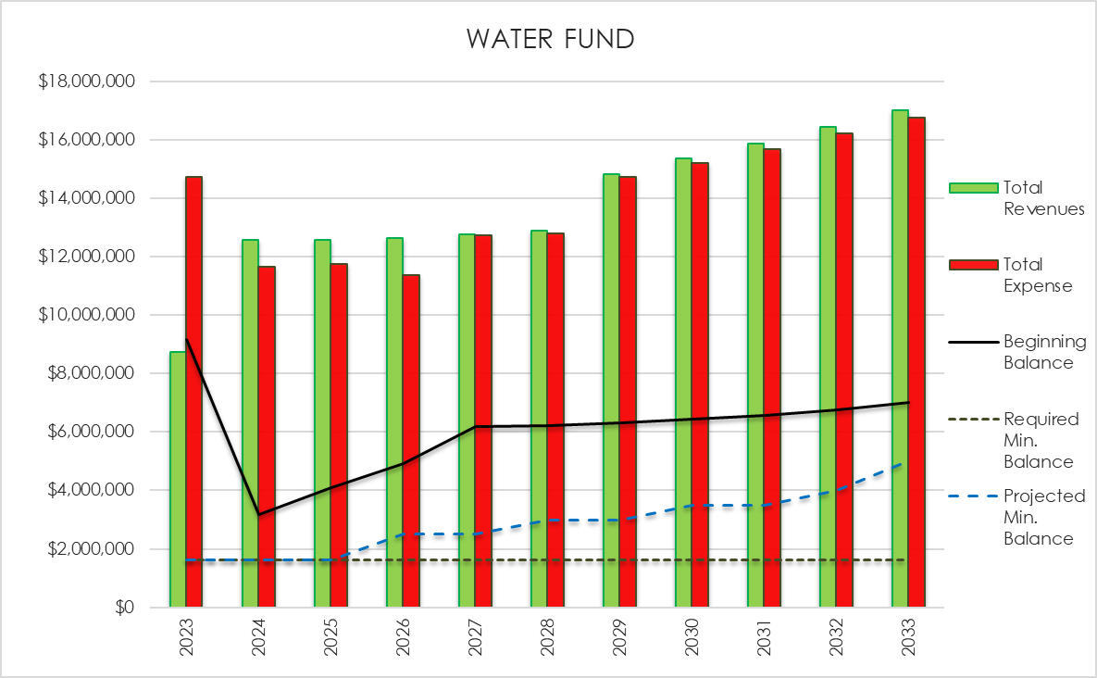

Slide 15
Water Production & Capacity
Current Findlay Water Treatment Plant
 | MGD
Target Production** | 8.50
Current Utilization | 6.21
Target Production Surplus | 2.29
Daily Flushing/Waste*** | 0.30
North Baltimore Usage | 0.55
Arlington Usage | 0.10
North Baltimore & Arlington Impact | 0.35
* Maximum Capacity is (16.0 MGD) the amount that the plant can technically produce on a daily basis. However, this does not allow for any system redundancy and would strain the system if used long term.
** Target Production is the current capacity which would be able to be sustained without losing redundancy and with no significant changes to the plant.
*** Currently the City of Findlay has to flush/dump 0.3 MGD at the north end flushing station to ensure water quality and water pressure is maintained.

